Slide 1
Vector Analysis

Slide 2
Scalars
A scalar is a quantity, such us temperature or energy, having only magnitude.
Symbolically, a scalar is represented by either lower or upper case letters.
Examples of Scalars are time, potential difference, distance, and coordinate variables; t, V, l and (x, y, z).

Slide 3
Vectors
A vector is a quantity, such as velocity or force, having magnitude and direction.
Graphically, a vector is represented by an arrow whose length represents its magnitude and arrowhead indicates its direction.

Slide 4
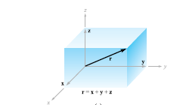

Slide 5
The vector F can be resolved into components parallel to the x, y and z directions of the right-hand rectangular coordinate system. In this coordinate system, the thumb points in +z direction when the fingers of the right hand rotate from +x to +y axes.

Slide 6
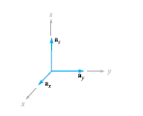

Slide 7
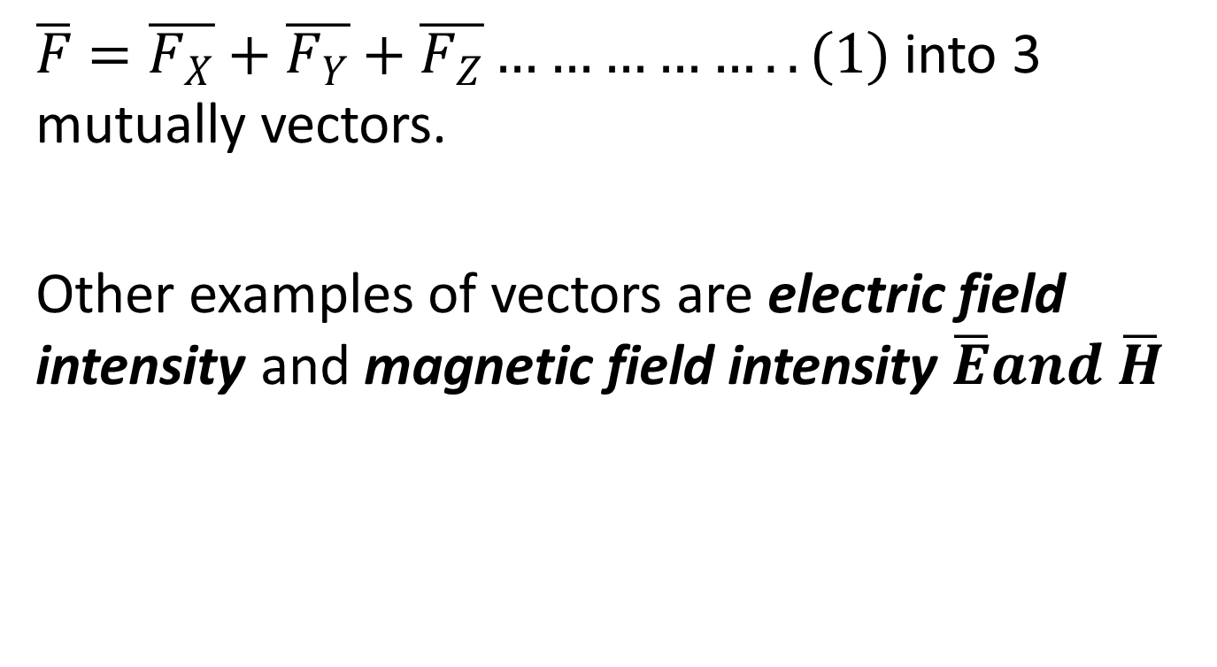
$\overline{F}=\overline{F_{X}}+\overline{F_{Y}}+\overline{F_{Z}}……………..(1)$ into 3 mutually vectors.
Other examples of vectors are electric field intensity and magnetic field intensity $\overline{E}and \overline{H}$

Slide 8
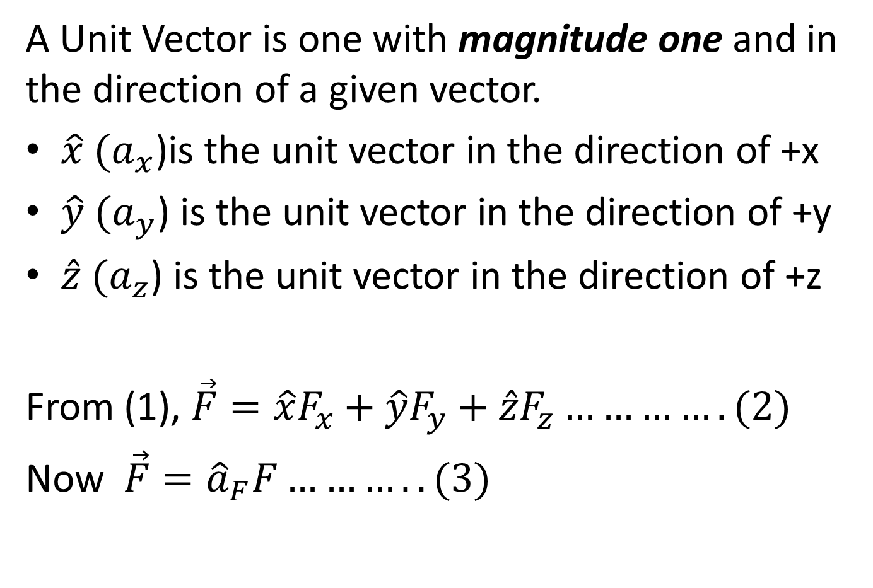
UNIT VECTORS
A Unit Vector is one with magnitude one and in the direction of a given vector.
$\hat{x}$ ${(a}_{x}$)is the unit vector in the direction of +x
$\hat{y}$ ${(a}_{y}$) is the unit vector in the direction of +y
$\hat{z}$ ${(a}_{z}$) is the unit vector in the direction of +z
From (1), $\vec{F}=\hat{x}F_{x}+\hat{y}F_{y}+\hat{z}F_{z}………….(2)$
Now $\vec{F}={\hat{a}}_{F}F………..(3)$

Slide 9
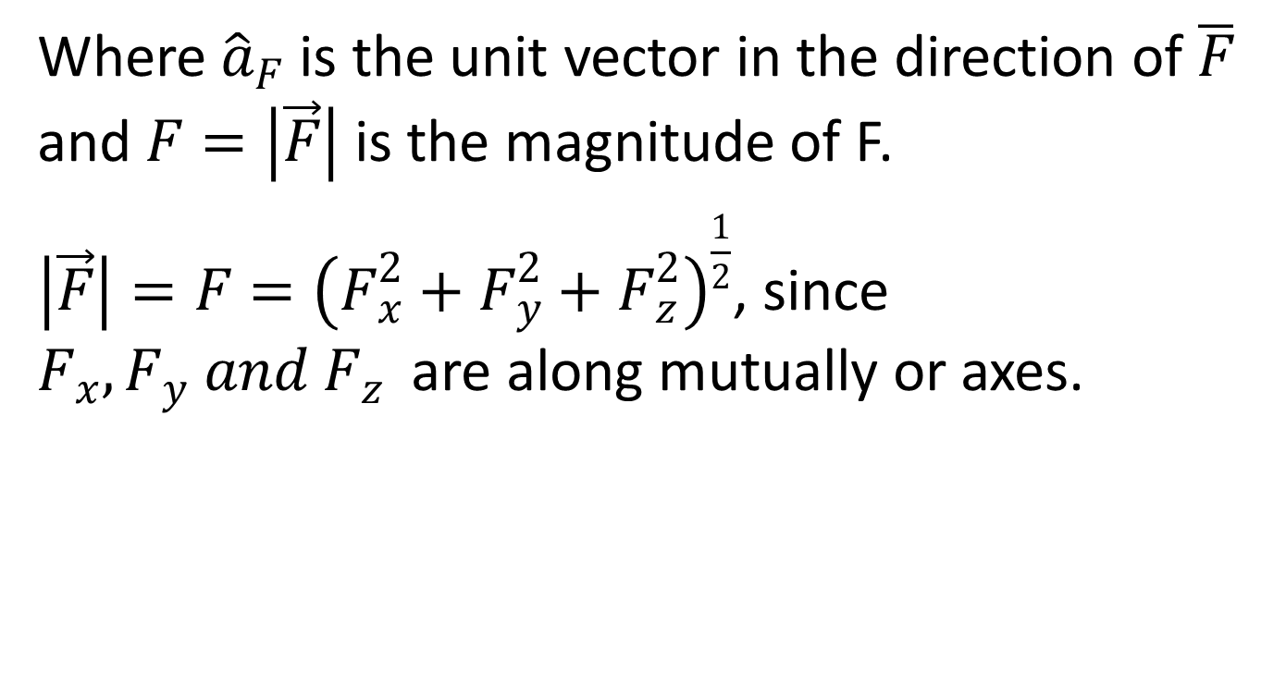
Where ${\hat{a}}_{F}$ is the unit vector in the direction of $\overline{F}$ and $F=\left|\vec{F}\right|$ is the magnitude of F.
$\left|\vec{F}\right|=F={\left(F_{x}^{2}+F_{y}^{2}+F_{z}^{2}\right)}^{\frac{1}{2}}$, since $F_{x}, F_{y} and F_{z}$are along mutually or axes.

Slide 10
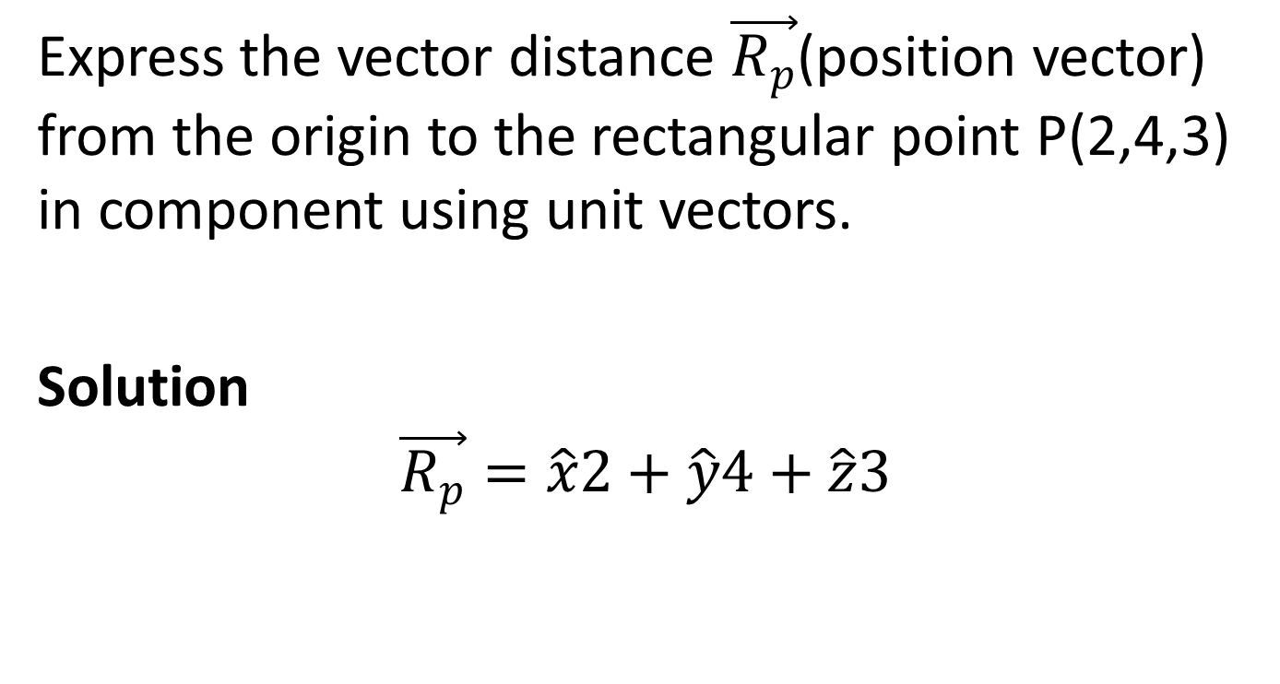
Example
Express the vector distance $\vec{R_{p}}$(position vector) from the origin to the rectangular point P(2,4,3) in component using unit vectors.
Solution
$$\vec{R_{p}}=\hat{x}2+\hat{y}4+\hat{z}3$$

Slide 11
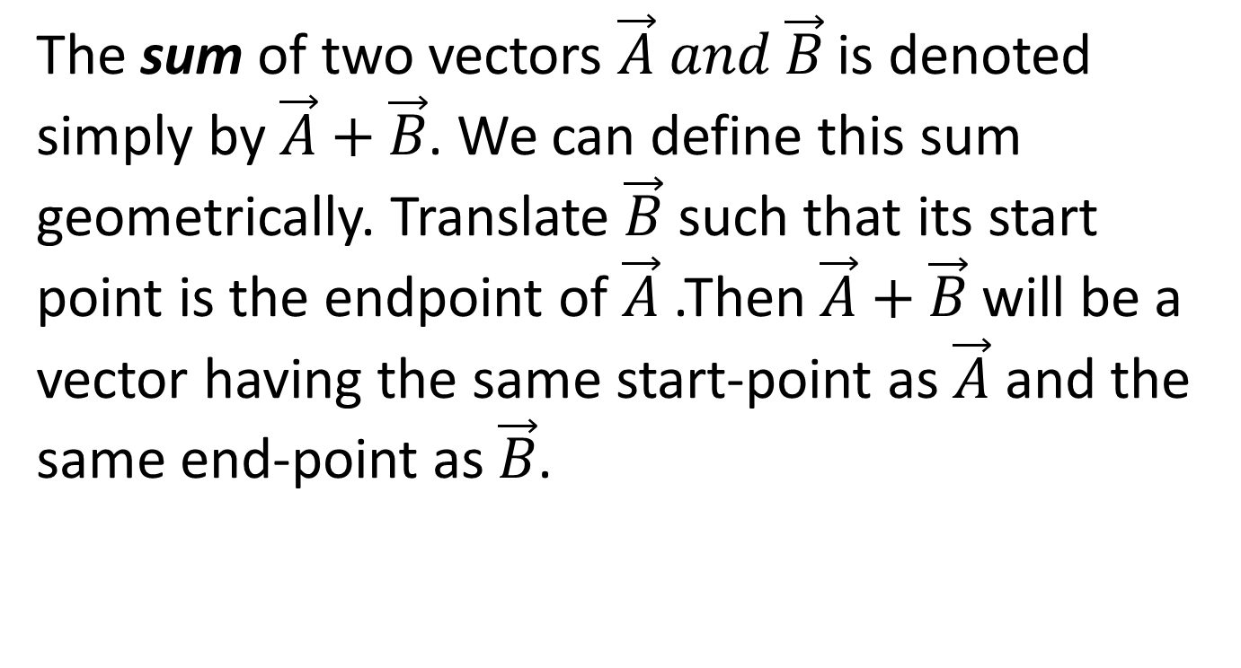
VECTOR ALGEBRA Addition of Vectors
The sum of two vectors $\vec{A} and \vec{B}$ is denoted simply by $\vec{A}+\vec{B}$. We can define this sum geometrically. Translate $\vec{B}$ such that its start point is the endpoint of $\vec{A}$ .Then $\vec{A}+\vec{B}$ will be a vector having the same start-point as $\vec{A}$ and the same end-point as $\vec{B}$.

Slide 12


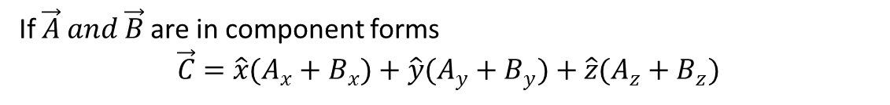
$$\vec{A}+\vec{B}=\vec{C}$$
If $\vec{A} and \vec{B}$ are in component forms
$$\vec{C}=\hat{x}(A_{x}+B_{x})+\hat{y}(A_{y}+B_{y})+\hat{z}(A_{z}+B_{z})$$

Slide 13
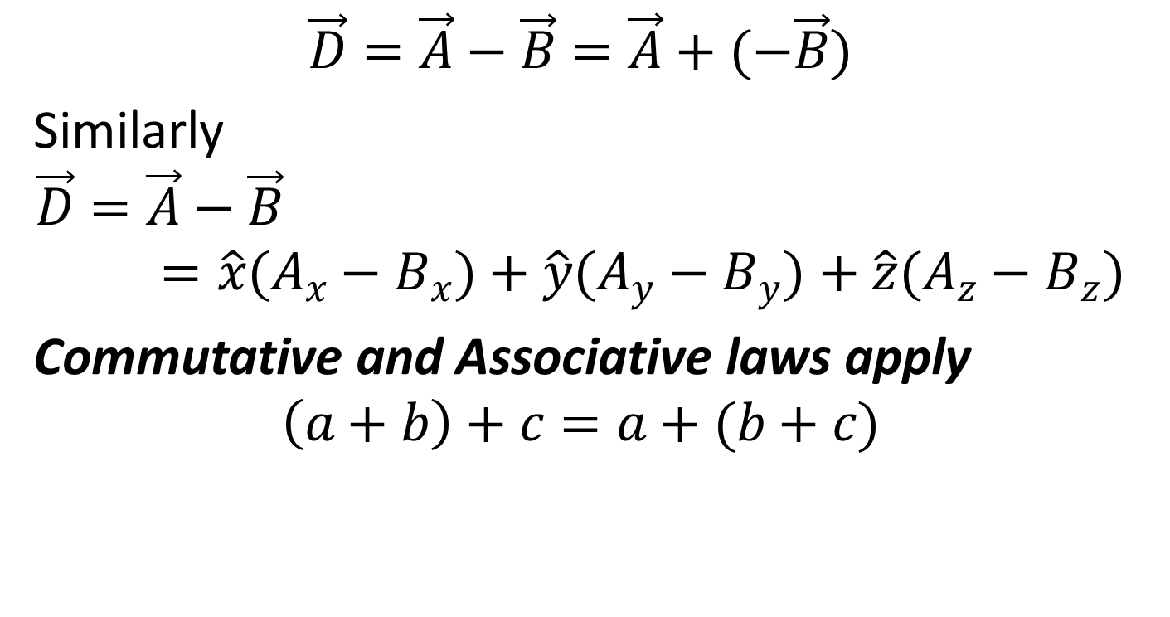
Subtraction of Vectors
$$\vec{D}=\vec{A}−\vec{B}=\vec{A}+(−\vec{B})$$
Similarly
$$\vec{D}=\vec{A}−\vec{B}=\hat{x}(A_{x}−B_{x})+\hat{y}(A_{y}−B_{y})+\hat{z}(A_{z}−B_{z})$$
Commutative and Associative laws apply
$$\left(a+b\right)+c=a+(b+c)$$

Slide 14
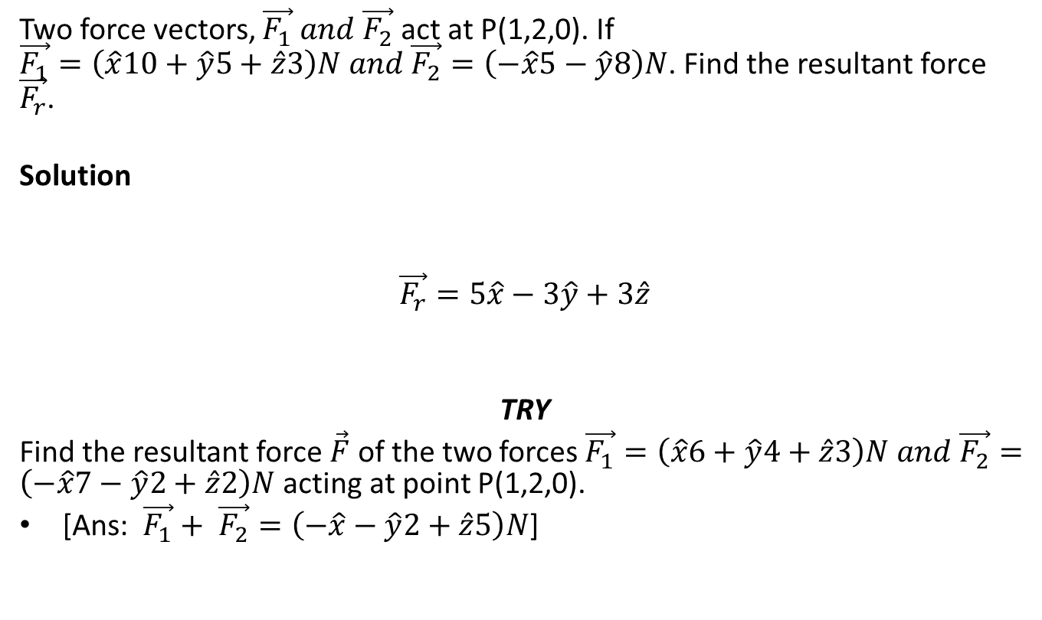
Example 1
Two force vectors, $\vec{F_{1}} and \vec{F_{2}}$ act at P(1,2,0). If $\vec{F_{1}}=\left(\hat{x}10+\hat{y}5+\hat{z}3\right)N and \vec{F_{2}}=\left(−\hat{x}5−\hat{y}8\right)N$. Find the resultant force $\vec{F_{r}}$.
Solution
$$\vec{F_{r}}=5\hat{x}−3\hat{y}+3\hat{z}$$
TRY
Find the resultant force $\vec{F}$ of the two forces $\vec{F_{1}}=\left(\hat{x}6+\hat{y}4+\hat{z}3\right)N and \vec{F_{2}}=\left(−\hat{x}7−\hat{y}2+\hat{z}2\right)N$ acting at point P(1,2,0).
[Ans: $\vec{F_{1}}+ \vec{F_{2}}=\left(−\hat{x}−\hat{y}2+\hat{z}5\right)N$]

Slide 15
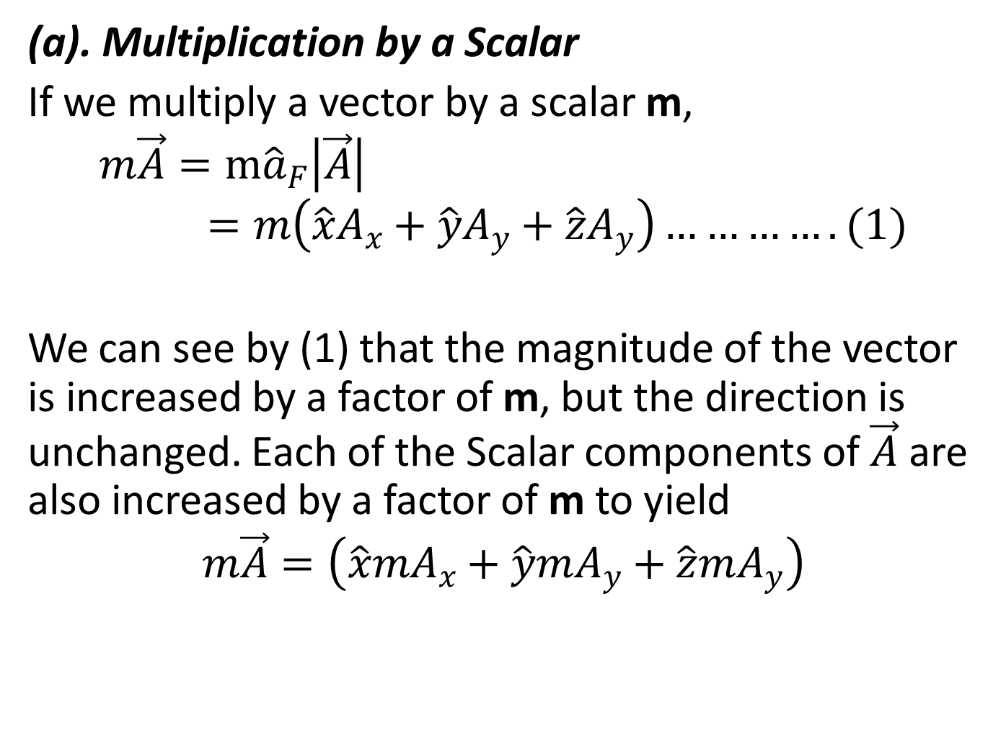
Vector Multiplication
(a). Multiplication by a Scalar
If we multiply a vector by a scalar m,
$$m\vec{A}=m{\hat{a}}_{F}\left|\vec{A}\right|=m\left(\hat{x}A_{x}+\hat{y}A_{y}+\hat{z}A_{y}\right)………….(1)$$
We can see by (1) that the magnitude of the vector is increased by a factor of m, but the direction is unchanged. Each of the Scalar components of $\vec{A}$ are also increased by a factor of m to yield
$$m\vec{A}=\left(\hat{x}mA_{x}+\hat{y}mA_{y}+\hat{z}{mA}_{y}\right)$$

Slide 16
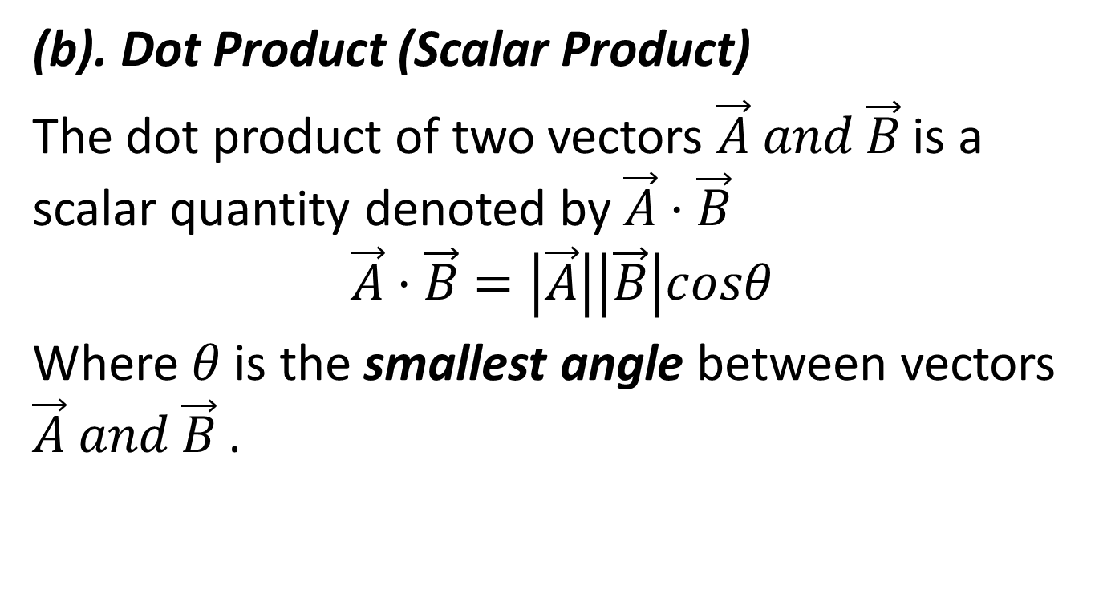
(b). Dot Product (Scalar Product)
The dot product of two vectors $\vec{A} and \vec{B}$ is a scalar quantity denoted by $\vec{A}·\vec{B}$
$$\vec{A}·\vec{B}=\left|\vec{A}\right|\left|\vec{B}\right|cosθ$$
Where $θ$ is the smallest angle between vectors $\vec{A} and \vec{B}$ .

Slide 17
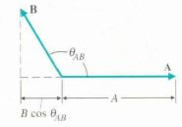
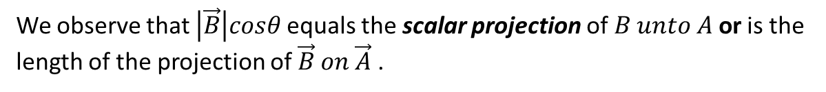

We observe that $\left|\vec{B}\right|cosθ$ equals the scalar projection of $B unto A$ or is the length of the projection of $\vec{B} on \vec{A}$ .
$$\vec{A}·\vec{B}=\vec{B}·\vec{A}$$

Slide 18
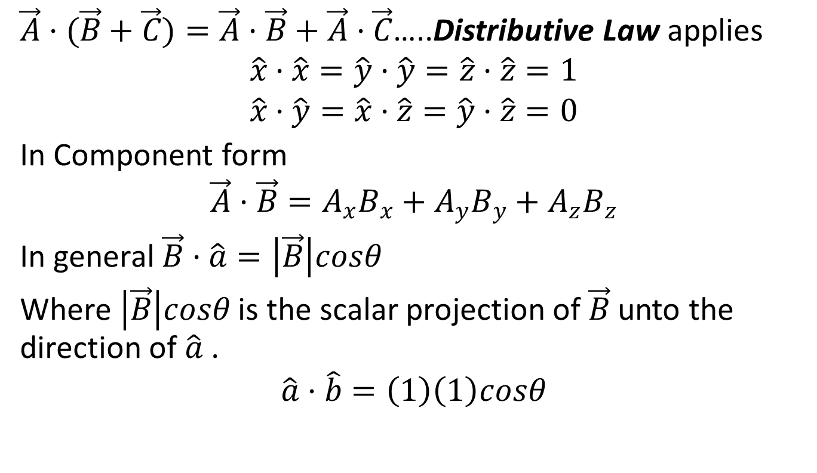
$\vec{A}·(\vec{B}+\vec{C})=\vec{A}·\vec{B}+\vec{A}·\vec{C}$…..Distributive Law applies
$$\hat{x}·\hat{x}=\hat{y}·\hat{y}=\hat{z}·\hat{z}=1$$
$$\hat{x}·\hat{y}=\hat{x}·\hat{z}=\hat{y}·\hat{z}=0$$
In Component form
$$\vec{A}·\vec{B}=A_{x}B_{x}+A_{y}B_{y}+A_{z}B_{z}$$
In general $\vec{B}·\hat{a}=\left|\vec{B}\right|cosθ$
Where $\left|\vec{B}\right|cosθ$ is the scalar projection of $\vec{B}$unto the direction of $\hat{a}$ .
$$\hat{a}·\hat{b}=\left(1\right)\left(1\right)cosθ$$

Slide 19
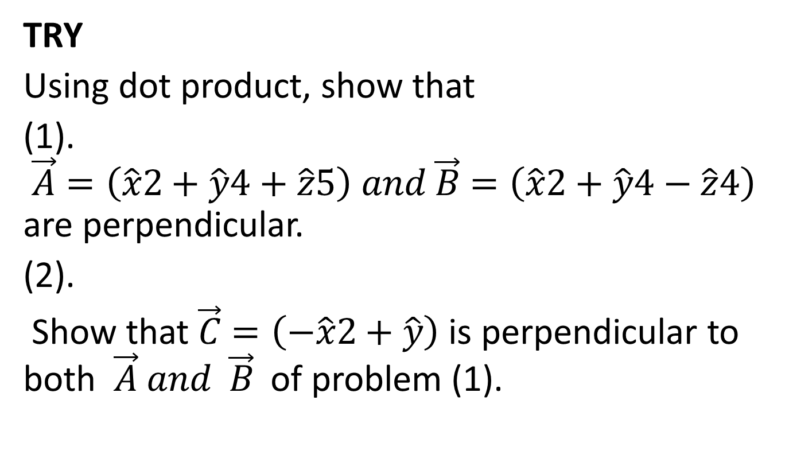
TRY
Using dot product, show that
(1). $\vec{A}=\left(\hat{x}2+\hat{y}4+\hat{z}5\right) and \vec{B}=\left(\hat{x}2+\hat{y}4−\hat{z}4\right)$ are perpendicular.
(2).
Show that $\vec{C}=\left(−\hat{x}2+\hat{y}\right)$ is perpendicular to both $\vec{A} and \vec{B}$ of problem (1).

Slide 20
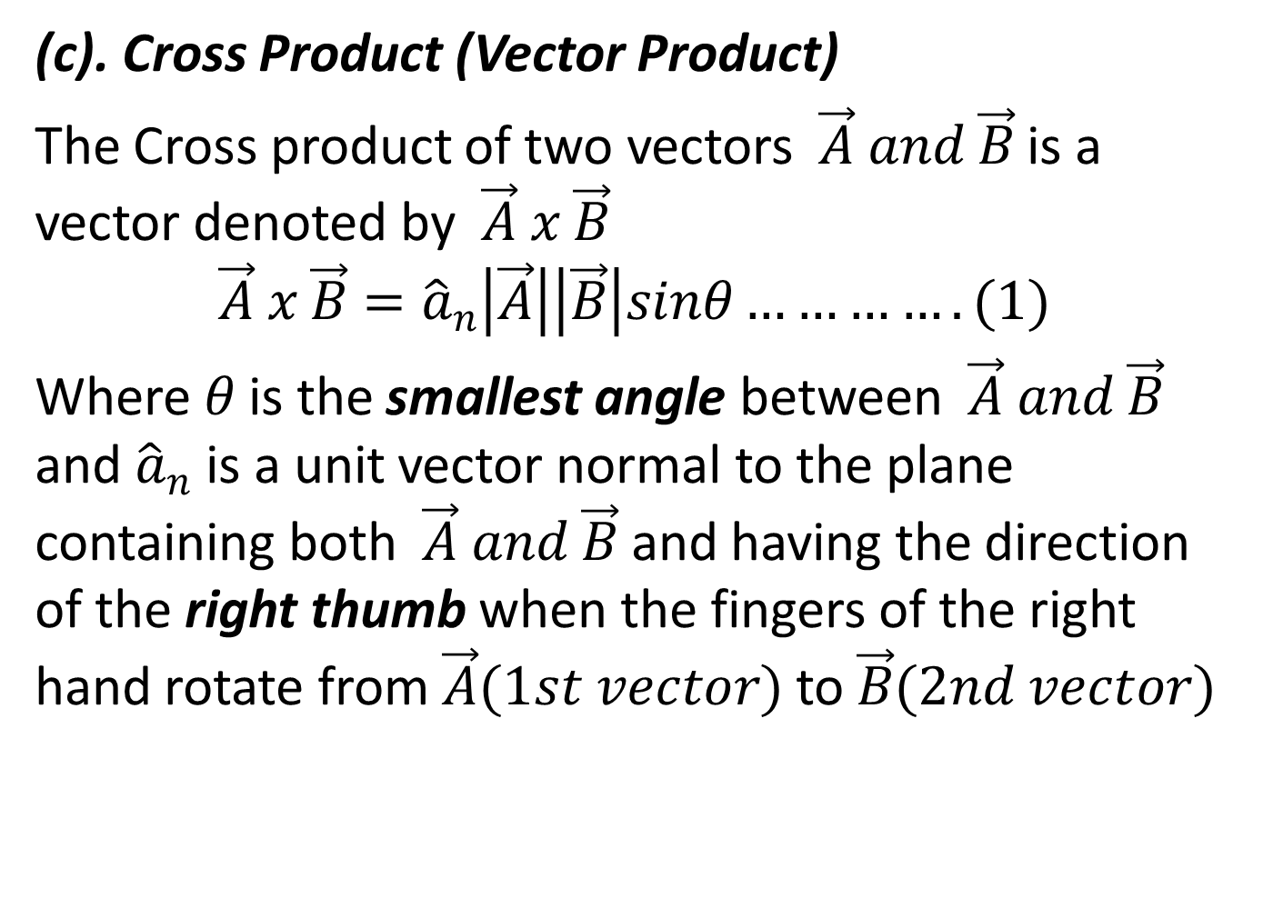
(c). Cross Product (Vector Product)
The Cross product of two vectors $\vec{A} and \vec{B}$ is a vector denoted by $\vec{A} x \vec{B}$
$$\vec{A} x \vec{B}={\hat{a}}_{n}\left|\vec{A}\right|\left|\vec{B}\right|sinθ………….(1)$$
Where $θ$ is the smallest angle between $\vec{A} and \vec{B}$ and ${\hat{a}}_{n}$ is a unit vector normal to the plane containing both $\vec{A} and \vec{B}$ and having the direction of the right thumb when the fingers of the right hand rotate from $\vec{A}(1st vector)$ to $\vec{B}(2nd vector)$

Slide 21
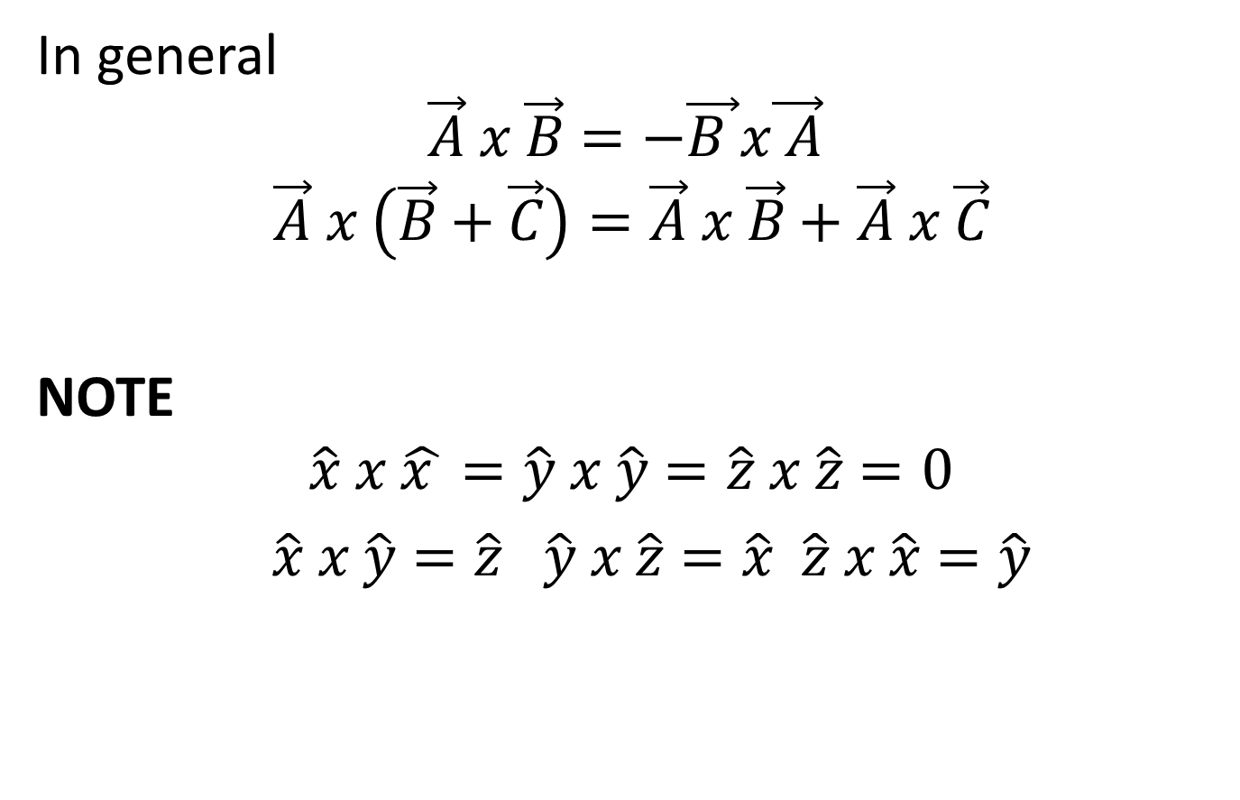
In general
$$\vec{A} x \vec{B}=−\vec{B }x\vec{ A}$$
$$\vec{A} x \left(\vec{B}+\vec{C}\right)=\vec{A} x \vec{B}+\vec{A} x \vec{C}$$
NOTE
$$\hat{x} x \hat{x }=\hat{y} x \hat{y}=\hat{z} x \hat{z}=0$$
$\hat{x} x \hat{y}=\hat{z} \hat{y} x \hat{z}=\hat{x} \hat{z} x \hat{x}=\hat{y}$

Slide 22
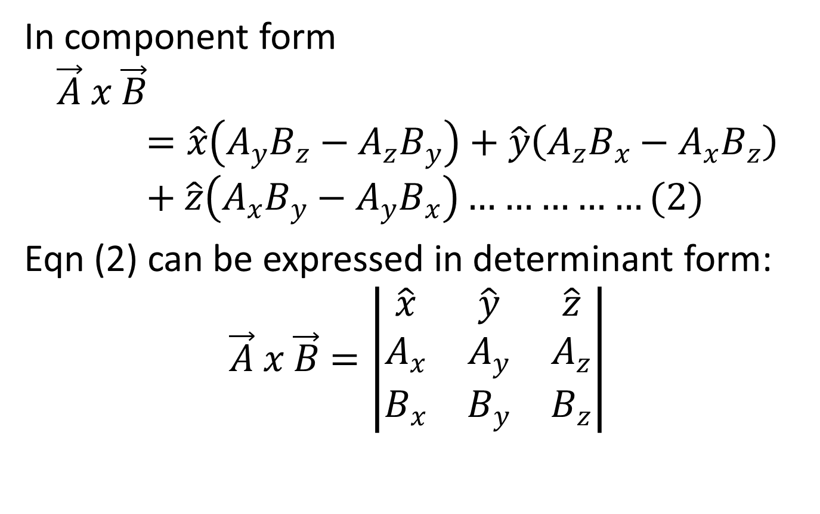
In component form
$$\vec{A} x \vec{B}=\hat{x}\left(A_{y}B_{z}−A_{z}B_{y}\right)+\hat{y}\left(A_{z}B_{x}−A_{x}B_{z}\right)+\hat{z}\left(A_{x}B_{y}−A_{y}B_{x}\right)……………(2)$$
Eqn (2) can be expressed in determinant form:
$$\vec{A} x \vec{B}=\left|\begin{matrix}\hat{x} & \hat{y} & \hat{z} \\ A_{x} & A_{y} & A_{z} \\ B_{x} & B_{y} & B_{z}\end{matrix}\right|$$

Slide 23
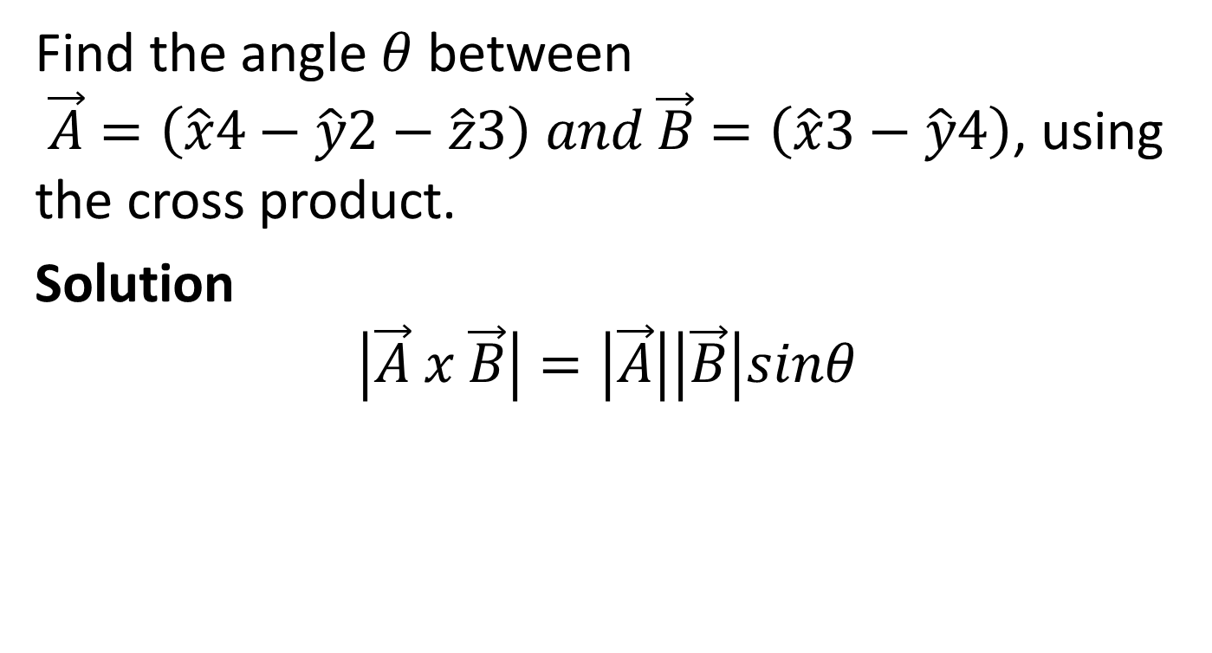
Example
Find the angle $θ$ between $\vec{A}=\left(\hat{x}4−\hat{y}2−\hat{z}3\right) and \vec{B}=\left(\hat{x}3−\hat{y}4\right)$, using the cross product.
Solution
$$\left|\vec{A} x \vec{B}\right|=\left|\vec{A}\right|\left|\vec{B}\right|sinθ$$

Slide 24
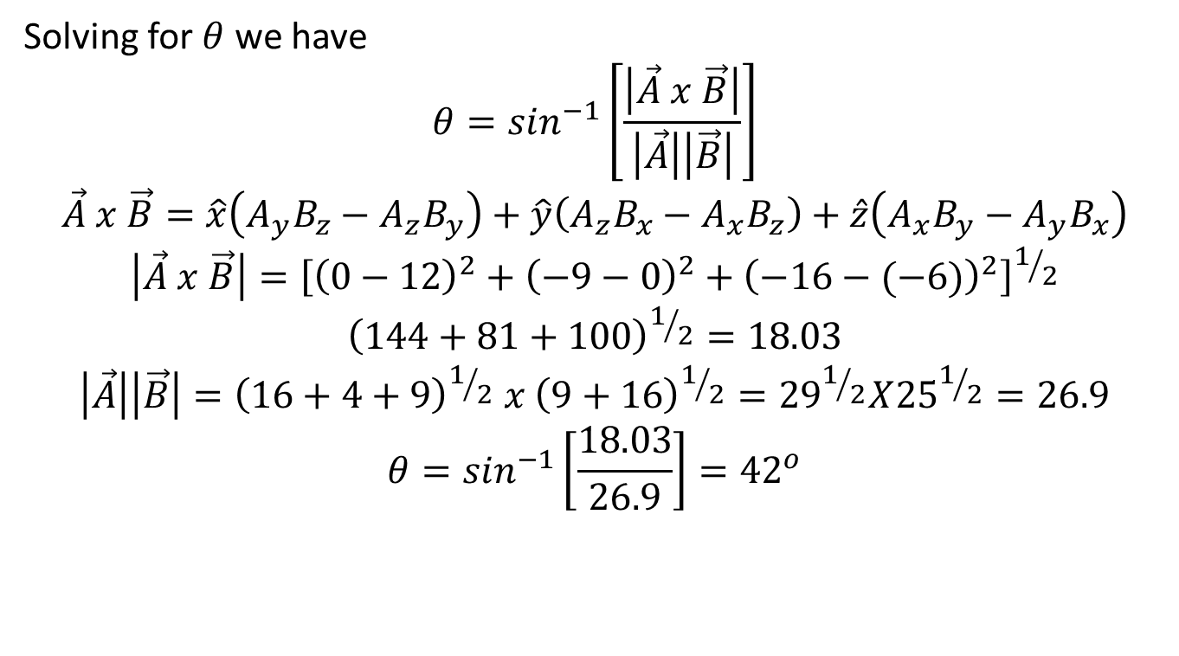
Solving for $θ$ we have
$$θ=\sin^{−1}\left[\frac{\left|\vec{A} x \vec{B}\right|}{\left|\vec{A}\right|\left|\vec{B}\right|}\right]$$
$$\vec{A} x \vec{B}=\hat{x}\left(A_{y}B_{z}−A_{z}B_{y}\right)+\hat{y}\left(A_{z}B_{x}−A_{x}B_{z}\right)+\hat{z}\left(A_{x}B_{y}−A_{y}B_{x}\right)$$
$$\left|\vec{A} x \vec{B}\right|={\left[{\left(0−12\right)}^{2}+{\left(−9−0\right)}^{2}+{\left(−16−(−6)\right)}^{2}\right]}^{1/2}$$
$${\left(144+81+100\right)}^{1/2}=18.03$$
$$\left|\vec{A}\right|\left|\vec{B}\right|={\left(16+4+9\right)}^{1/2} x {\left(9+16\right)}^{1/2}={29}^{1/2}X{25}^{1/2}=26.9$$
$$θ=\sin^{−1}\left[\frac{18.03}{26.9}\right]={42}^{o}$$

Slide 25

TRY
If$\vec{A}=\left(\hat{x}3−\hat{y}+\hat{z}2\right) and \vec{B}=\left(\hat{x}2+\hat{y}2−\hat{z}\right)$. Find $\vec{A} x \vec{B}$

Slide 26
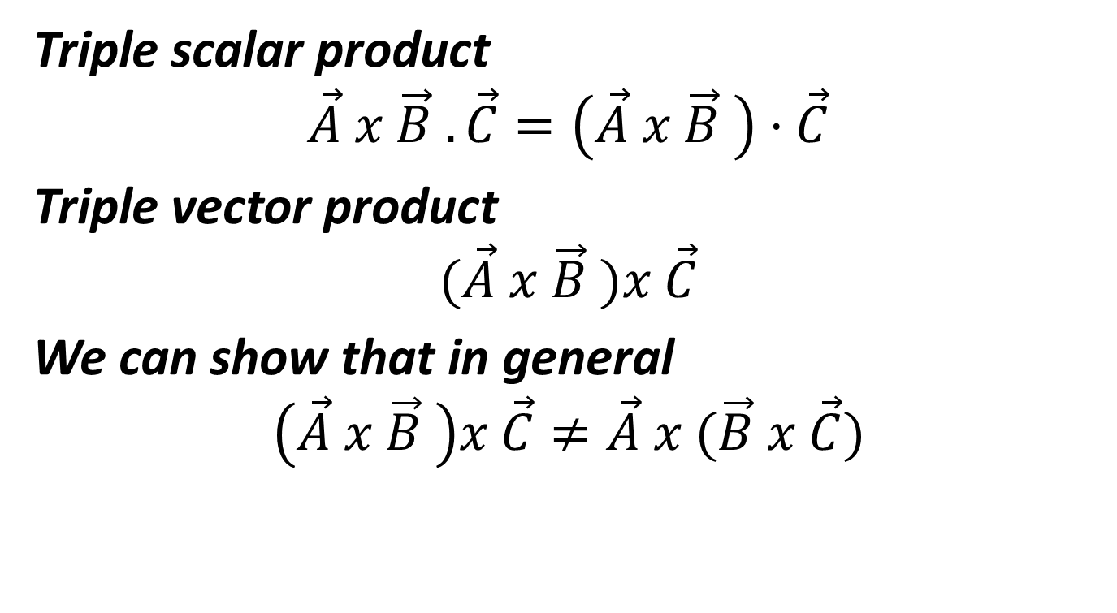
Triple scalar product
$$\vec{A} x \vec{B} . \vec{C}=\left(\vec{A} x \vec{B} \right)·\vec{C}$$
Triple vector product
$$(\vec{A} x \vec{B} )x \vec{C}$$
We can show that in general
$$\left(\vec{A} x \vec{B} \right)x \vec{C}≠\vec{A} x (\vec{B} x \vec{C})$$

Slide 27
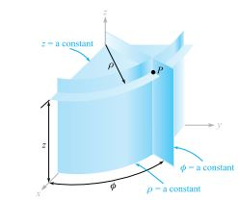

CYLINDRICAL COORDINATE SYSTEM
In a cylindrical coordinate system, a point in space is uniquely defined by three variables $ρ(r_{c}),∅ and z$ as seen in fig.1.

Slide 28
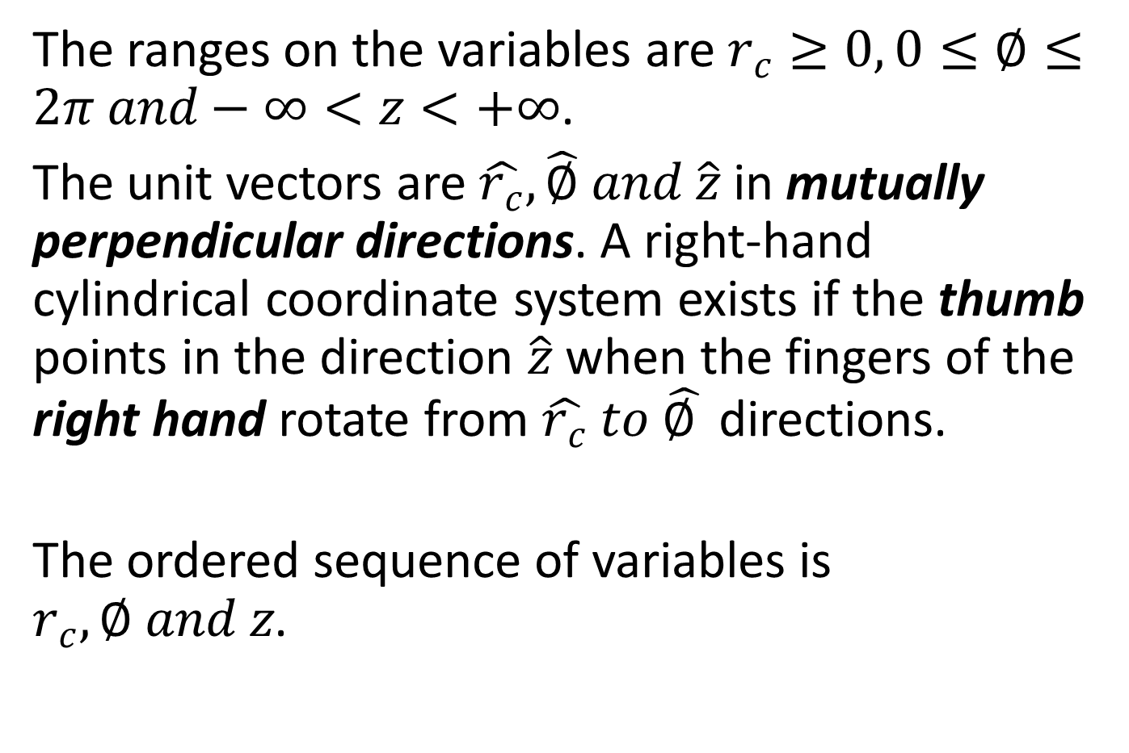
The ranges on the variables are $r_{c}≥0, 0≤∅≤2π and−∞<z<+∞$.
The unit vectors are $\hat{r_{c}}, \hat{∅} and \hat{z}$ in mutually perpendicular directions. A right-hand cylindrical coordinate system exists if the thumb points in the direction $\hat{z}$ when the fingers of the right hand rotate from $\hat{r_{c}} to \hat{∅ }$ directions.
The ordered sequence of variables is $r_{c},∅ and z$.

Slide 29
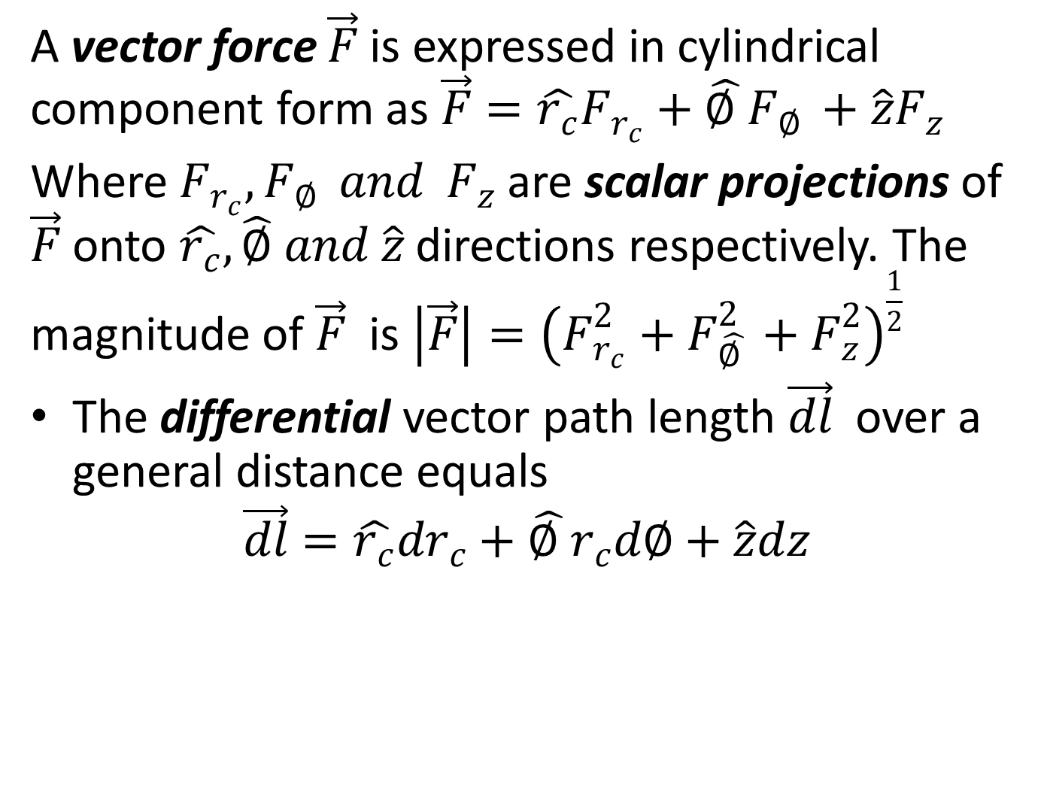
A vector force $\vec{F}$ is expressed in cylindrical component form as $\vec{F}=\hat{r_{c}}F_{r_{c}}+\hat{∅ }F_{∅ }+\hat{z}F_{z}$
Where $F_{r_{c}},F_{∅ } and F_{z}$ are scalar projections of $\vec{F}$ onto $\hat{r_{c}}, \hat{∅} and \hat{z}$ directions respectively. The magnitude of $\vec{F}$ is $\left|\vec{F}\right|={\left(F_{r_{c}}^{2}+F_{\hat{∅ }}^{2}+F_{z}^{2}\right)}^{\frac{1}{2}}$
The differential vector path length $\vec{dl}$ over a general distance equals
$$\vec{dl}=\hat{r_{c}}dr_{c}+\hat{∅ }r_{c}d∅+\hat{z}dz$$

Slide 30
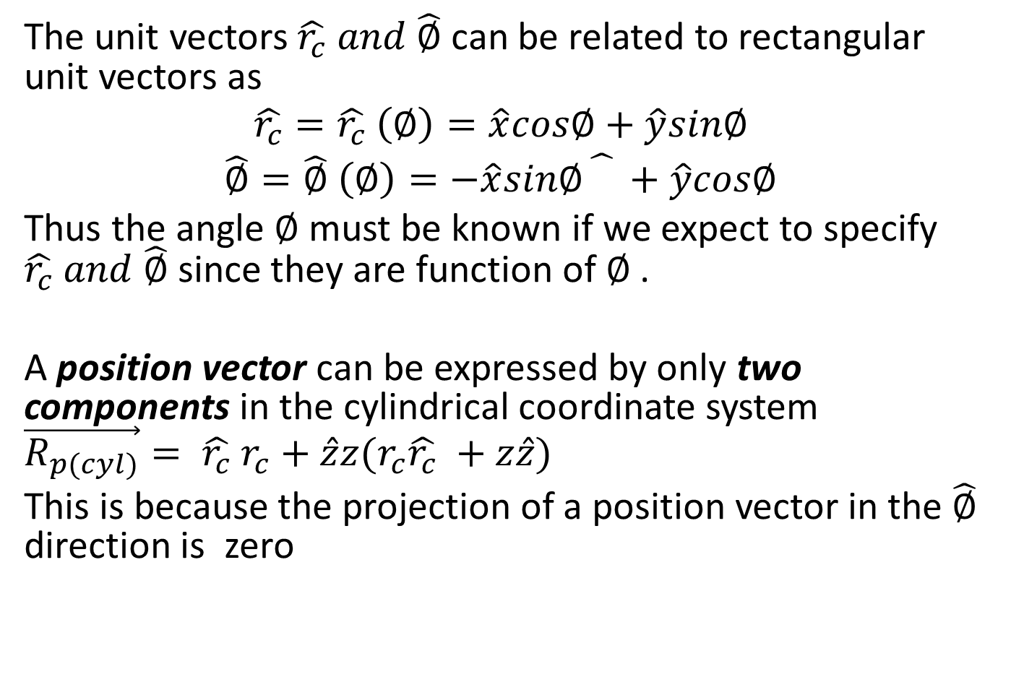
The unit vectors $\hat{r_{c}} and \hat{∅}$ can be related to rectangular unit vectors as
$$\hat{r_{c}}=\hat{r_{c}} \left(∅\right)=\hat{x}cos∅+\hat{y}sin∅$$
$$\hat{∅}=\hat{∅} \left(∅\right)=−\hat{x}sin∅\hat{}+\hat{y}cos∅$$
Thus the angle $∅$ must be known if we expect to specify $\hat{r_{c}} and \hat{∅}$ since they are function of $∅$ .
A position vector can be expressed by only two components in the cylindrical coordinate system $\vec{R_{p(cyl)}}= \hat{r_{c}} r_{c}+\hat{z}z(r_{c}\hat{r_{c}} +z\hat{z})$
This is because the projection of a position vector in the $\hat{∅}$ direction is zero

Slide 31
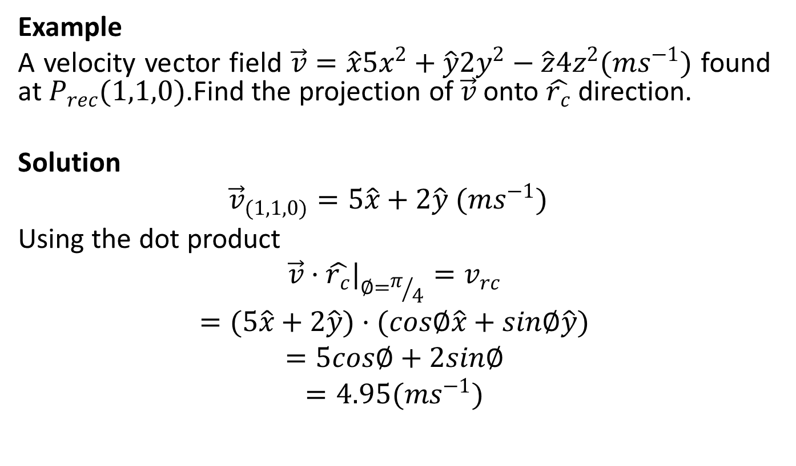
Example
A velocity vector field $\vec{v}=\hat{x}5x^{2}+\hat{y}2y^{2}−\hat{z}4z^{2}(ms^{−1})$ found at $P_{rec}(1,1,0)$.Find the projection of $\vec{v}$ onto $\hat{r_{c}}$ direction.
Solution
$${\vec{v}}_{(1,1,0)}=5\hat{x}+2\hat{y} (ms^{−1})$$
Using the dot product
$${\vec{v}·\hat{r_{c}}|}_{∅=π/4}=v_{rc}$$
$$=(5\hat{x}+2\hat{y})·(cos∅\hat{x}+sin∅\hat{y})$$
$$=5cos∅+2sin∅$$
$$=4.95(ms^{−1})$$

Slide 32
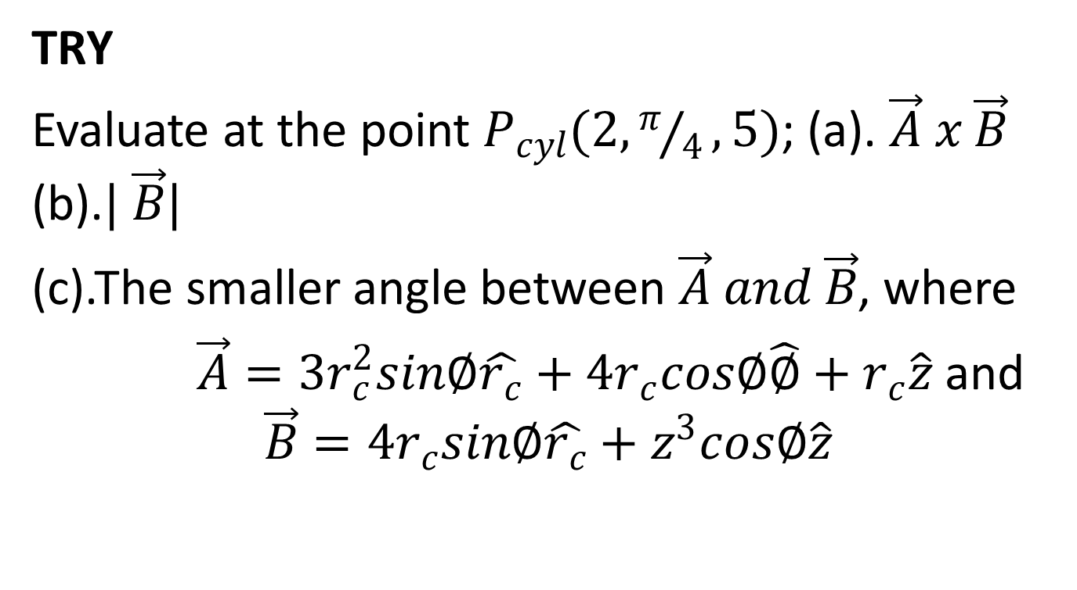
TRY
Evaluate at the point $P_{cyl}(2,π/4,5)$; (a). $\vec{A} x \vec{B}$ (b).$| \vec{B}|$
(c).The smaller angle between $\vec{A} and \vec{B}$, where
$\vec{A}=3r_{c}^{2}sin∅\hat{r_{c}}+4r_{c}cos∅\hat{∅}+r_{c}\hat{z}$ and
$$\vec{B}=4r_{c}sin∅\hat{r_{c}}+z^{3}cos∅\hat{z}$$

Slide 33
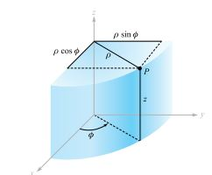
The variables of the rectangular and cylindrical coordinate system are easily related to each other.

Slide 34
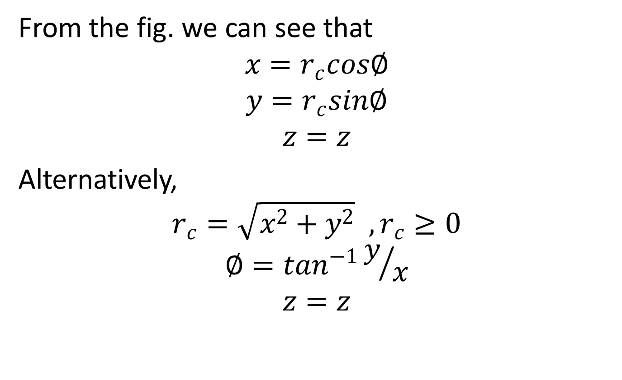
From the fig. we can see that
$$x=r_{c}cos∅$$
$$y=r_{c}sin∅$$
$$z=z$$
Alternatively,
$$r_{c}=\sqrt{x^{2}+y^{2}} ,r_{c}≥0$$
$$∅=\tan^{−1}y/x$$
$$z=z$$

Slide 35
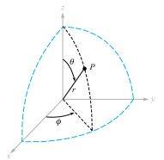

SPHERICAL COORDINATE SYSTEM
In a spherical coordinate system, a point in space is uniquely defined by three variables,$r_{s},θ and ∅$ as seen in fig.1.

Slide 36
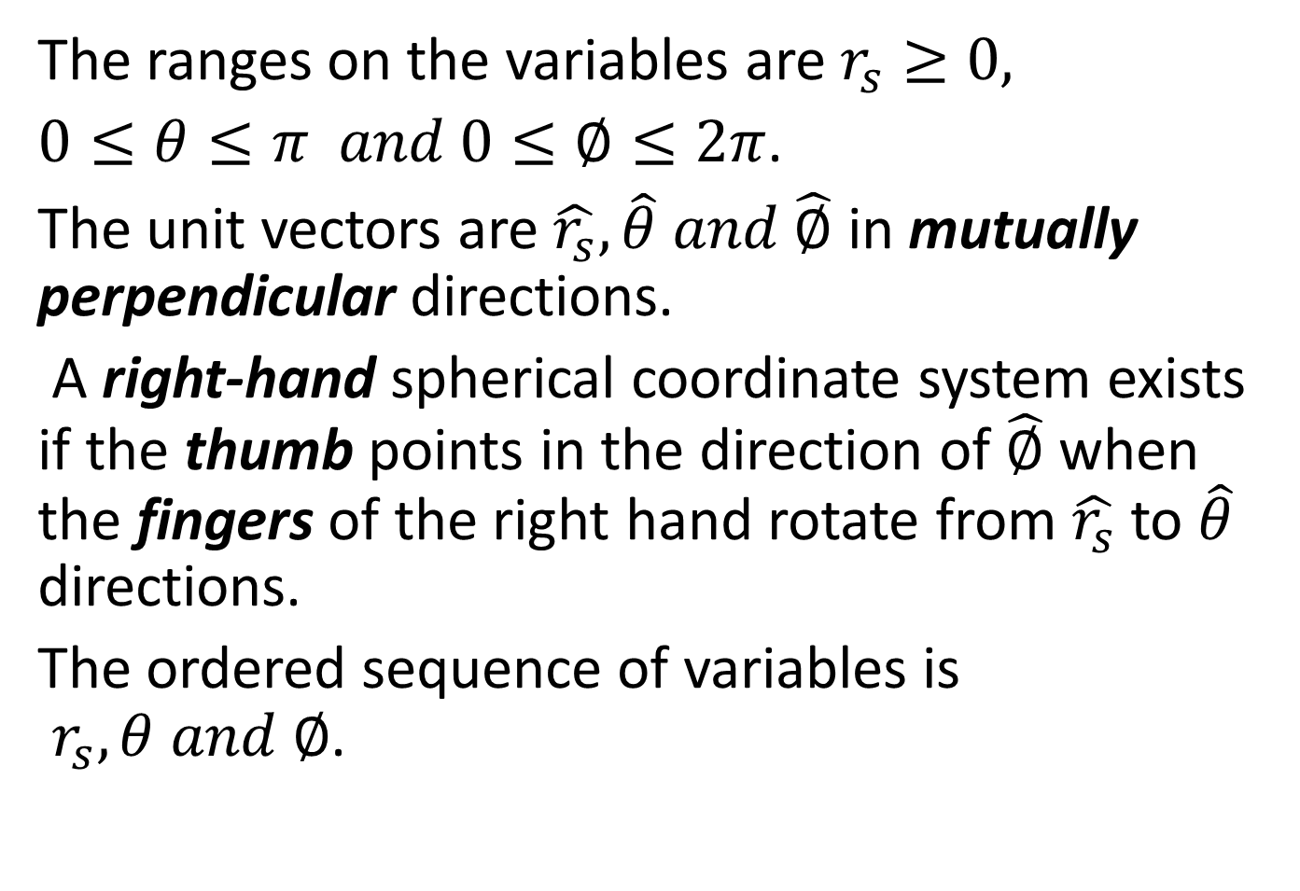
The ranges on the variables are $r_{s}≥0,$
$0≤θ≤π and 0≤∅≤2π$.
The unit vectors are $\hat{r_{s}},\hat{θ} and \hat{∅}$ in mutually perpendicular directions.
A right-hand spherical coordinate system exists if the thumb points in the direction of $\hat{∅}$ when the fingers of the right hand rotate from $\hat{r_{s}}$ to $\hat{θ}$ directions.
The ordered sequence of variables is $r_{s},θ and ∅$.

Slide 37
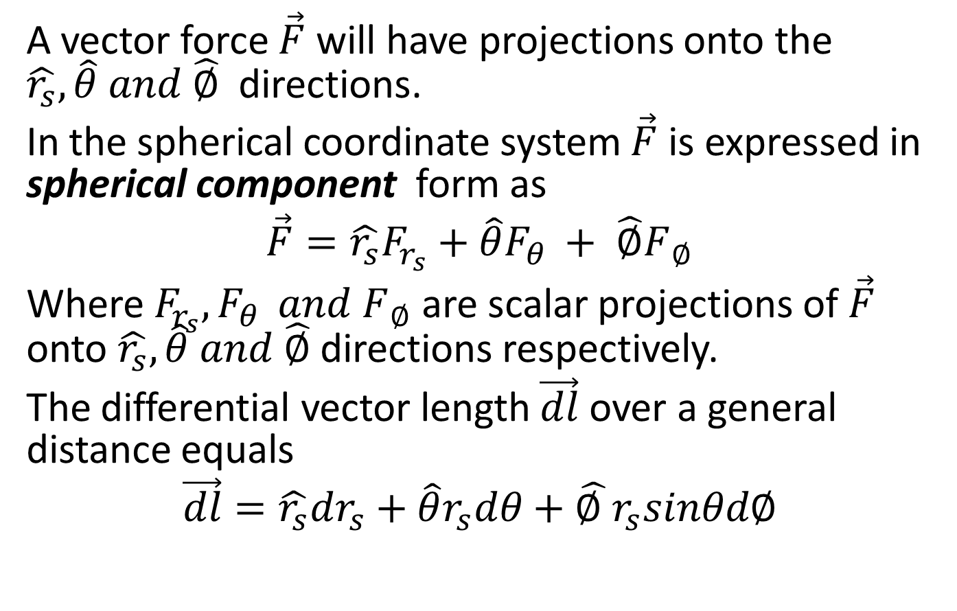
A vector force $\vec{F}$ will have projections onto the $\hat{r_{s}},\hat{θ} and \hat{∅}$ directions.
In the spherical coordinate system $\vec{F}$ is expressed in spherical component form as
$$\vec{F}=\hat{r_{s}}F_{r_{s}}+\hat{θ}F_{θ }+ \hat{∅}F_{ ∅}$$
Where $F_{r_{s}},F_{θ } and F_{ ∅}$ are scalar projections of $\vec{F}$ onto $\hat{r_{s}},\hat{θ} and \hat{∅}$ directions respectively.
The differential vector length $\vec{dl}$ over a general distance equals
$$\vec{dl}=\hat{r_{s}}dr_{s}+\hat{θ}r_{s}dθ+\hat{∅ }r_{s}sinθd∅$$

Slide 38
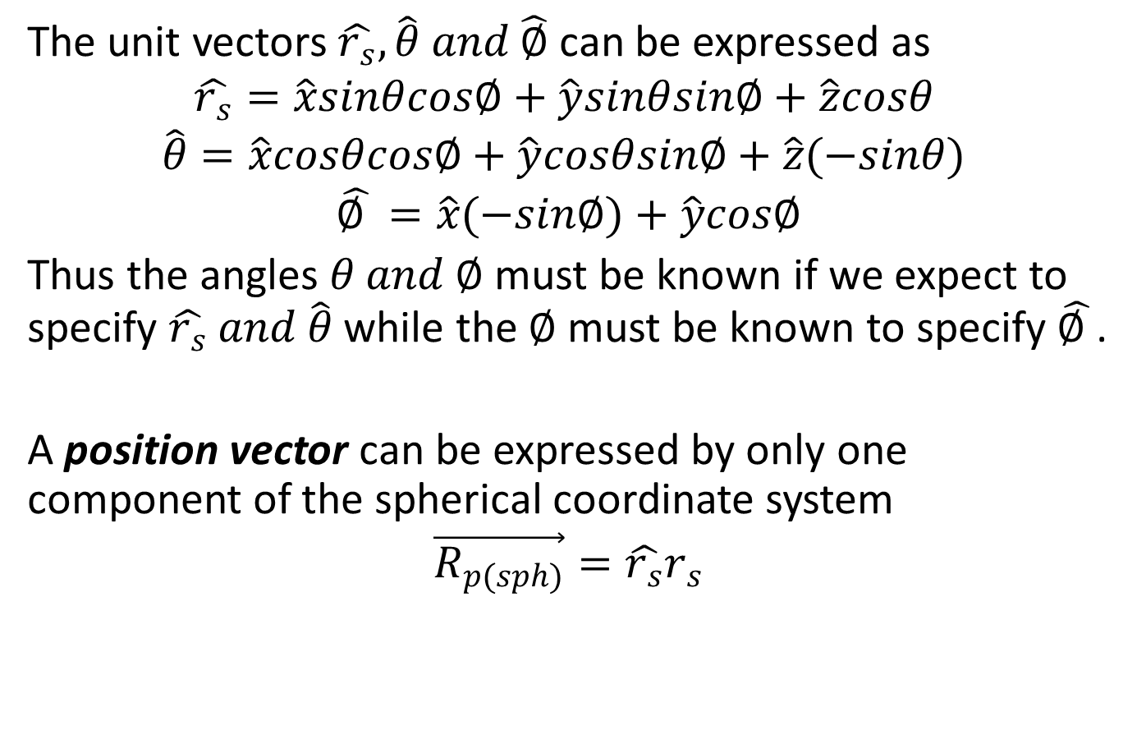
The unit vectors $\hat{r_{s}},\hat{θ} and \hat{∅}$ can be expressed as
$$\hat{r_{s}}=\hat{x}sinθcos∅+\hat{y}sinθsin∅+\hat{z}cosθ$$
$$\hat{θ}=\hat{x}cosθcos∅+\hat{y}cosθsin∅+\hat{z}(−sinθ)$$
$$\hat{∅ }=\hat{x}(−sin∅)+\hat{y}cos∅$$
Thus the angles $θ and ∅$ must be known if we expect to specify $\hat{r_{s}} and \hat{θ}$ while the $∅$ must be known to specify $\hat{∅ }$.
A position vector can be expressed by only one component of the spherical coordinate system
$$\vec{R_{p(sph)}}=\hat{r_{s}}r_{s}$$

Slide 39
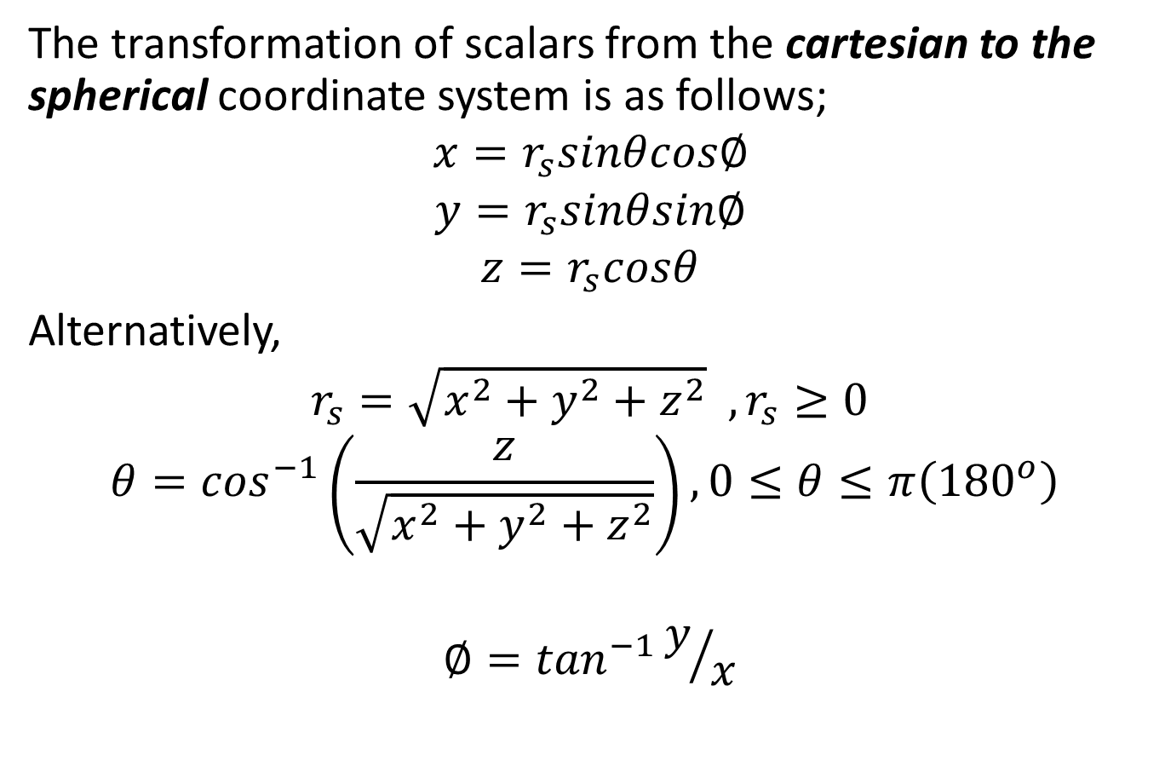
The transformation of scalars from the cartesian to the spherical coordinate system is as follows;
$$x=r_{s}sinθcos∅$$
$$y=r_{s}sinθsin∅$$
$$z=r_{s}cosθ$$
Alternatively,
$$r_{s}=\sqrt{x^{2}+y^{2}+z^{2}} ,r_{s}≥0$$
$$θ=\cos^{−1}\left(\frac{z}{\sqrt{x^{2}+y^{2}+z^{2}}}\right), 0≤θ≤π\left({180}^{o}\right)$$
$$∅=\tan^{−1}y/x$$

Slide 40
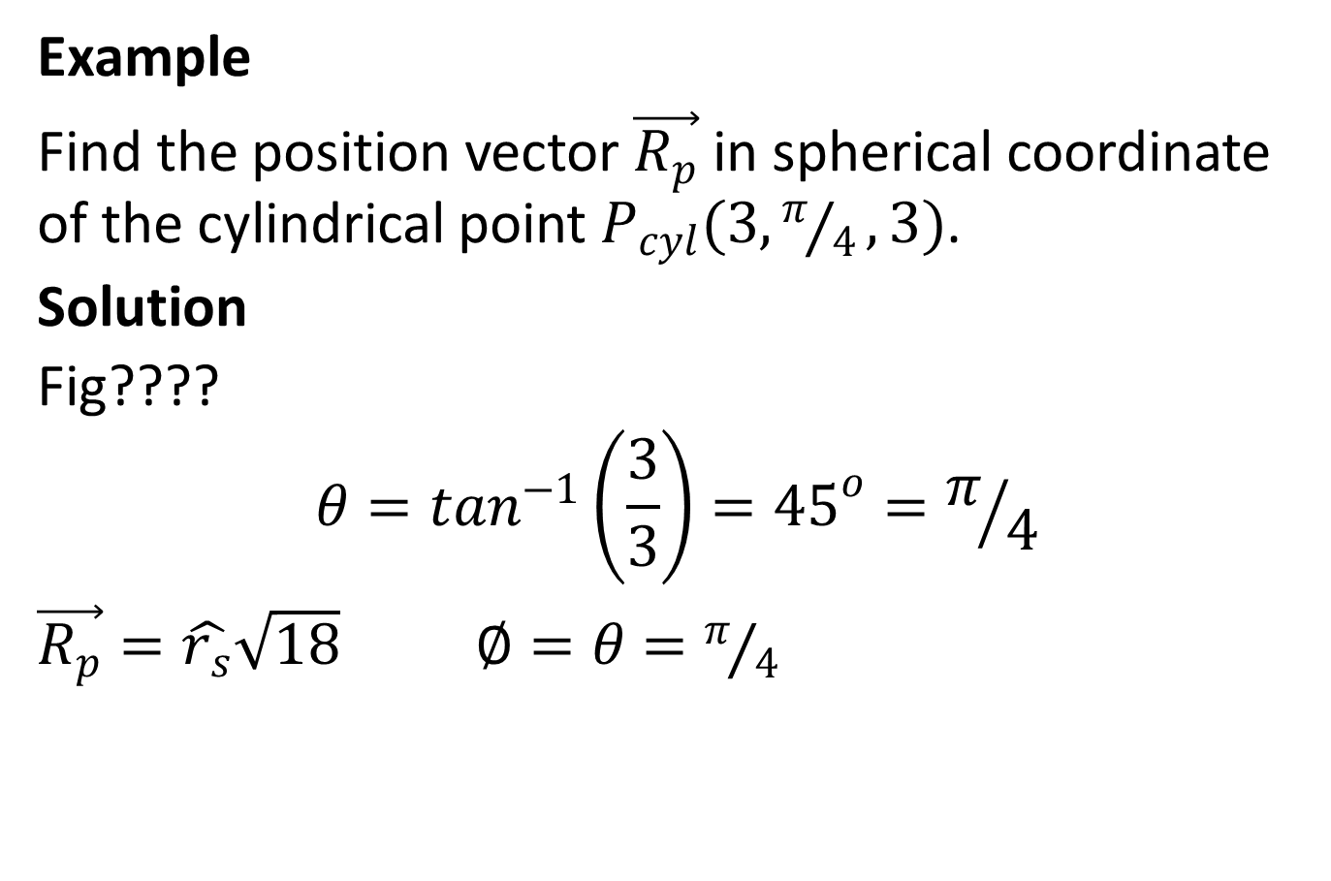
Example
Find the position vector $\vec{R_{p}}$ in spherical coordinate of the cylindrical point $P_{cyl}(3,π/4,3)$.
Solution
Fig????
$$θ=\tan^{−1}\left(\frac{3}{3}\right)={45}^{o}=π/4$$
$\vec{R_{p}}=\hat{r_{s}}\sqrt{18} ∅=θ=π/4$

Slide 41
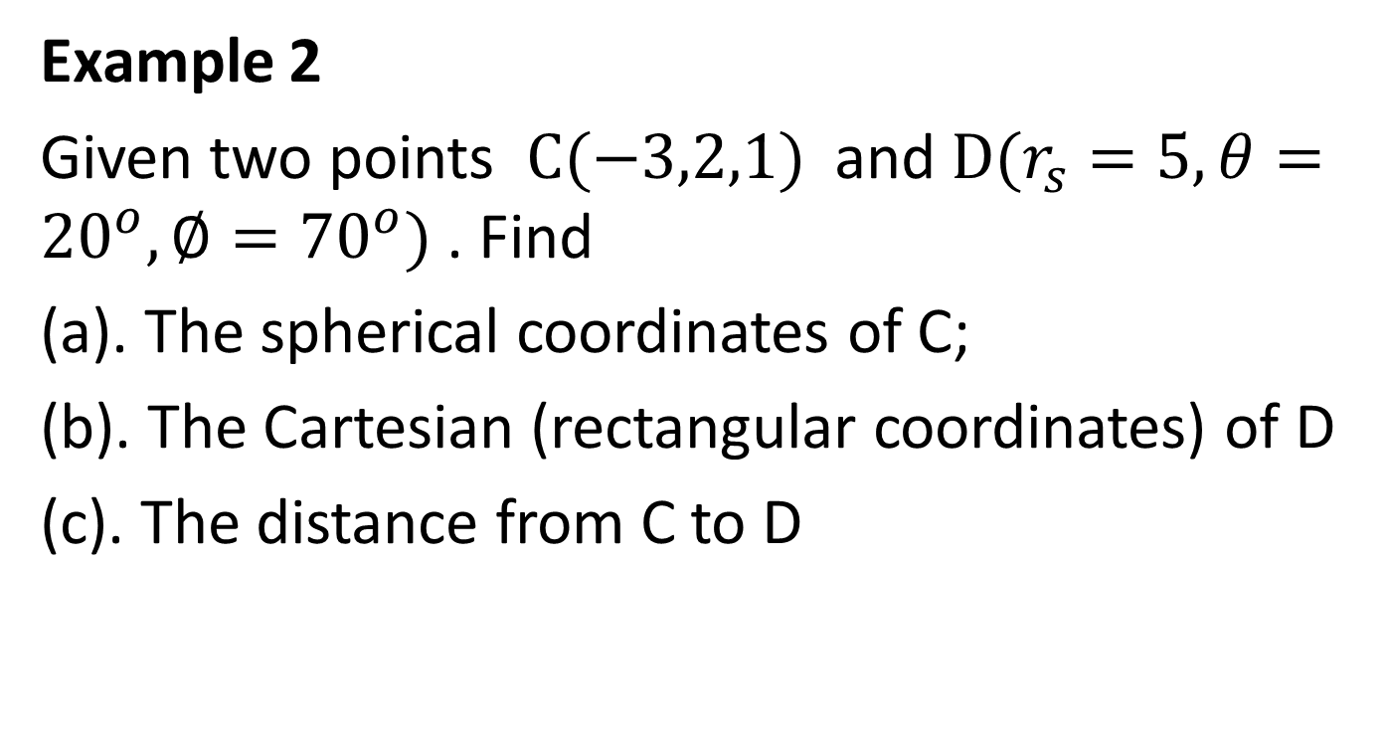
Example 2
Given two points $C(−3,2,1)$ and $D(r_{s}=5,θ={20}^{o},∅={70}^{o})$. Find
(a). The spherical coordinates of C;
(b). The Cartesian (rectangular coordinates) of D
(c). The distance from C to D

Slide 42
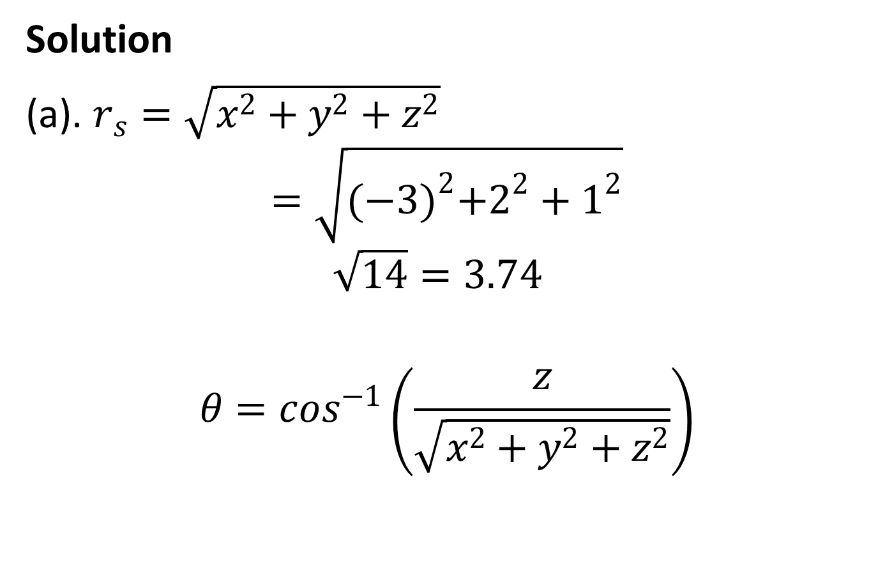
Solution
(a). $r_{s}=\sqrt{x^{2}+y^{2}+z^{2}}$
$$=\sqrt{{(−3)}^{2}+2^{2}+1^{2}}$$
$$\sqrt{14}=3.74$$
$$θ=\cos^{−1}\left(\frac{z}{\sqrt{x^{2}+y^{2}+z^{2}}}\right)$$

Slide 43

$$=\cos^{−1}\left(\frac{1}{\sqrt{14}}\right)=74.499={75}^{o})$$
$$∅=\tan^{−1}y/x$$
$$=\tan^{−1}2/{−3}$$
$$={−33.69}^{o}+{180}^{o}={146.3}^{o}$$

Slide 44
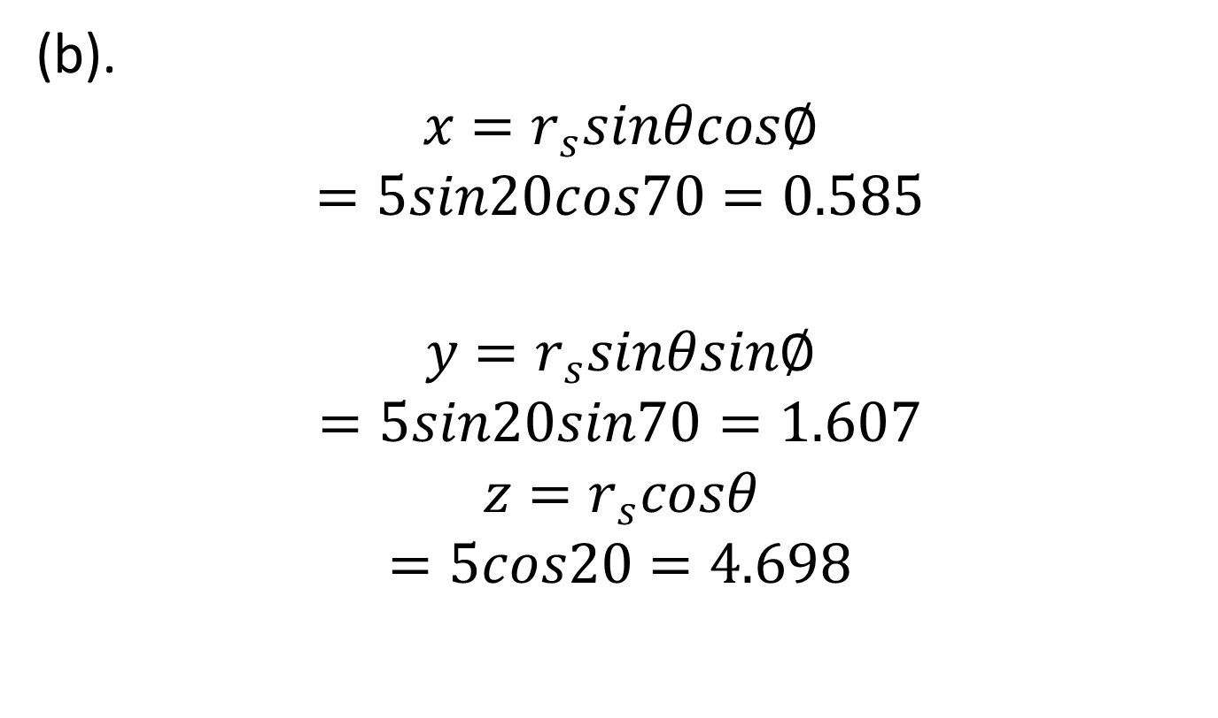
(b).
$$x=r_{s}sinθcos∅$$
$$=5sin20cos70=0.585$$
$$y=r_{s}sinθsin∅$$
$$=5sin20sin70=1.607$$
$$z=r_{s}cosθ$$
$$=5cos20=4.698$$

Slide 45
TRANSFORMATION OF VECTORS
There will be many occasions when it becomes desirable to transform a vector from one coordinate system to another.
For a vector to be expressed in a single coordinate system, it must satisfy the following 3 requirements.
1. Contain unit vectors only of a single coordinate system.
2. Contain scalar projections only onto the unit vector directions of a single coordinate system.
3. Contain variables only of a single coordinate system.

Slide 46
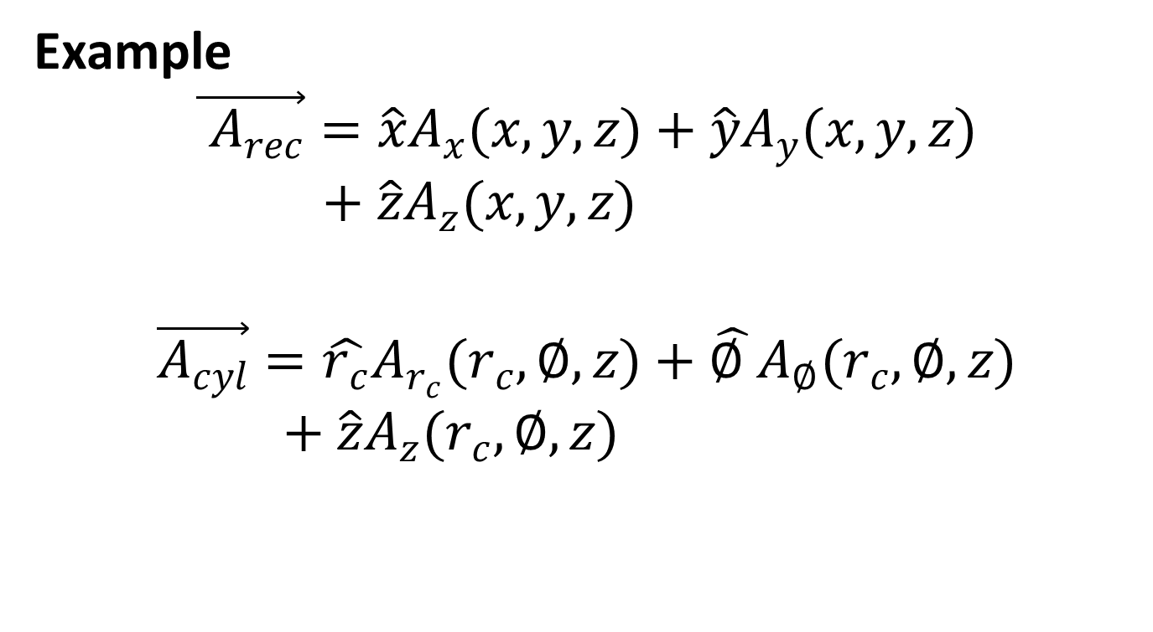
Example
$$\vec{{ A}_{rec}}=\hat{x}A_{x}(x,y,z)+\hat{y}A_{y}(x,y,z)+\hat{z}A_{z}(x,y,z)$$
$$\vec{A_{cyl}}=\hat{r_{c}}A_{r_{c}}(r_{c},∅,z)+\hat{∅ }A_{∅}(r_{c},∅,z)+\hat{z}A_{z}(r_{c},∅,z)$$

Slide 47
The 3 steps involved in transforming a vector are;
Step 1: Write the general vector expression using the vectors of the new coordinate system.
Step 2: Evaluate the scalar projections onto unit vector directions of the new coordinate system.
Step 3: Change variables from old to new coordinate system.

Slide 48
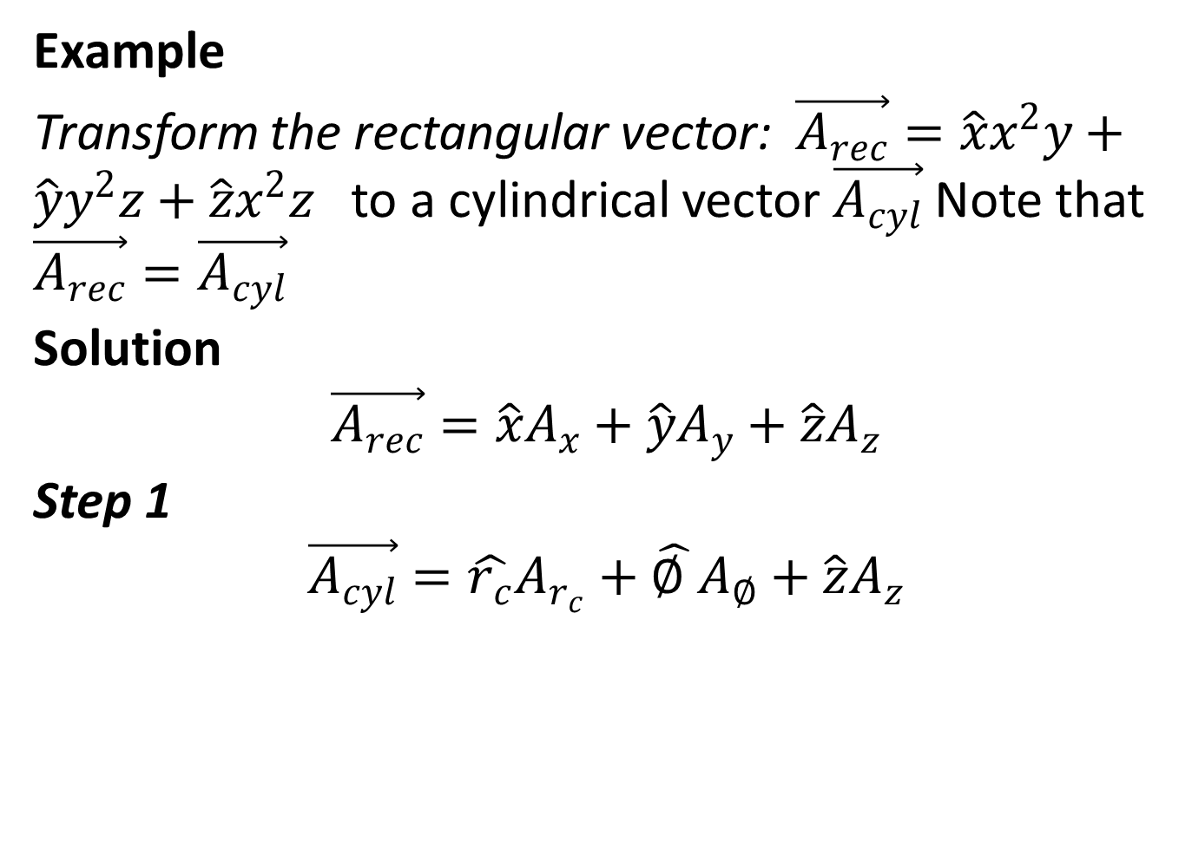
Example
Transform the rectangular vector: $\vec{A_{rec}}=\hat{x}x^{2}y+\hat{y}y^{2}z+\hat{z}x^{2}z$ to a cylindrical vector $\vec{A_{cyl}}$ Note that $\vec{A_{rec}}=\vec{A_{cyl}}$
Solution
$$\vec{A_{rec}}=\hat{x}A_{x}+\hat{y}A_{y}+\hat{z}A_{z}$$
Step 1
$$\vec{A_{cyl}}=\hat{r_{c}}A_{r_{c}}+\hat{∅ }A_{∅}+\hat{z}A_{z}$$

Slide 49
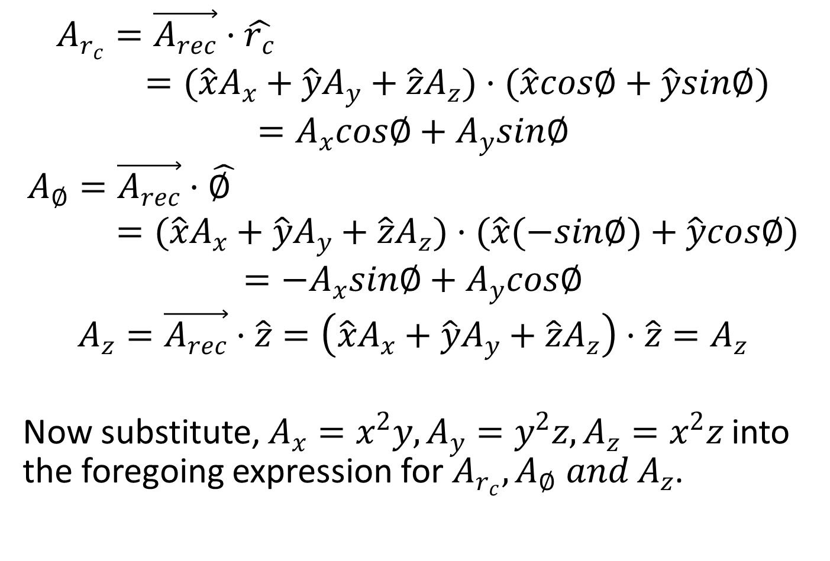
$$A_{r_{c}}=\vec{A_{rec}}·\hat{r_{c}}=(\hat{x}A_{x}+\hat{y}A_{y}+\hat{z}A_{z})·(\hat{x}cos∅+\hat{y}sin∅)$$
$$=A_{x}cos∅+A_{y}sin∅$$
$$A_{∅}=\vec{A_{rec}}·\hat{∅ }=(\hat{x}A_{x}+\hat{y}A_{y}+\hat{z}A_{z})·(\hat{x}(−sin∅)+\hat{y}cos∅)$$
$$=−A_{x}sin∅+A_{y}cos∅$$
$$A_{z}=\vec{A_{rec}}·\hat{z}=\left(\hat{x}A_{x}+\hat{y}A_{y}+\hat{z}A_{z}\right)·\hat{z}=A_{z}$$
Now substitute, $A_{x}=x^{2}y,A_{y}=y^{2}z,A_{z}=x^{2}z$ into the foregoing expression for $A_{r_{c}},A_{∅} and A_{z}$.

Slide 50
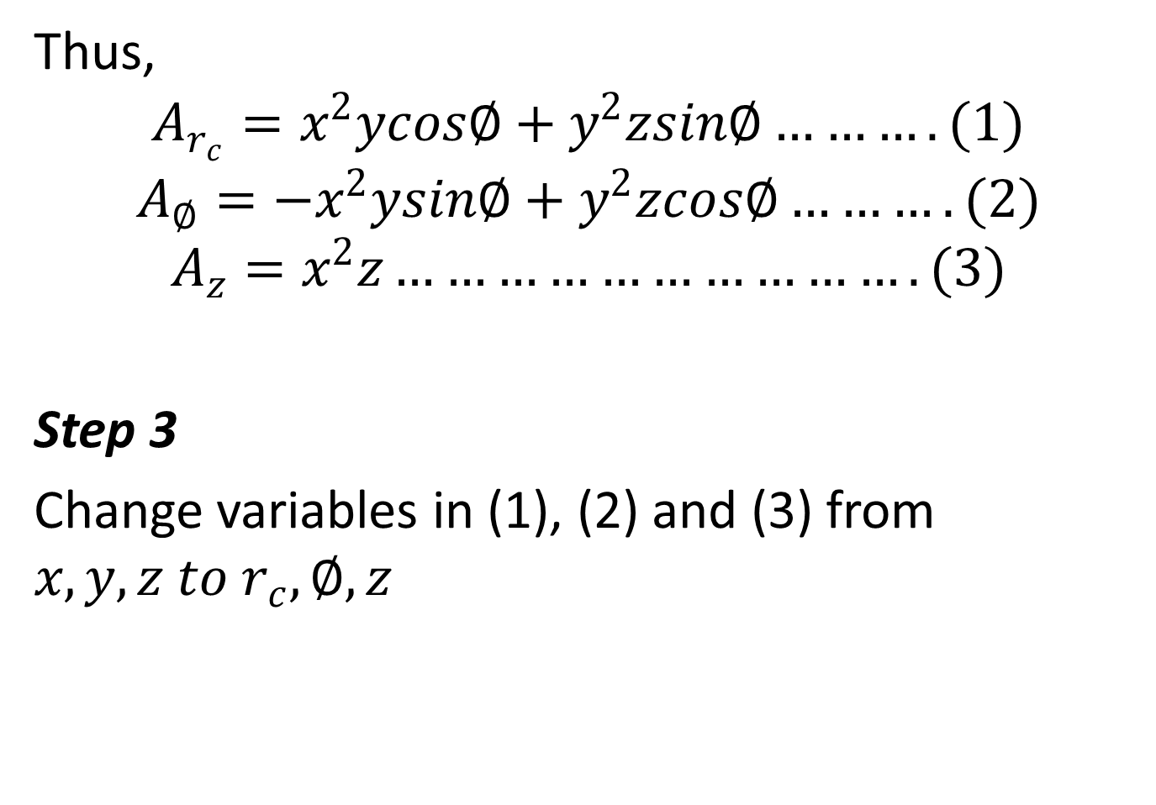
Thus,
$$A_{r_{c}}=x^{2}ycos∅+y^{2}zsin∅……….(1)$$
$$A_{∅}=−x^{2}ysin∅+y^{2}zcos∅……….(2)$$
$$A_{z}=x^{2}z………………………….(3)$$
Step 3
Change variables in (1), (2) and (3) from $x,y,z to r_{c},∅,z$

Slide 51
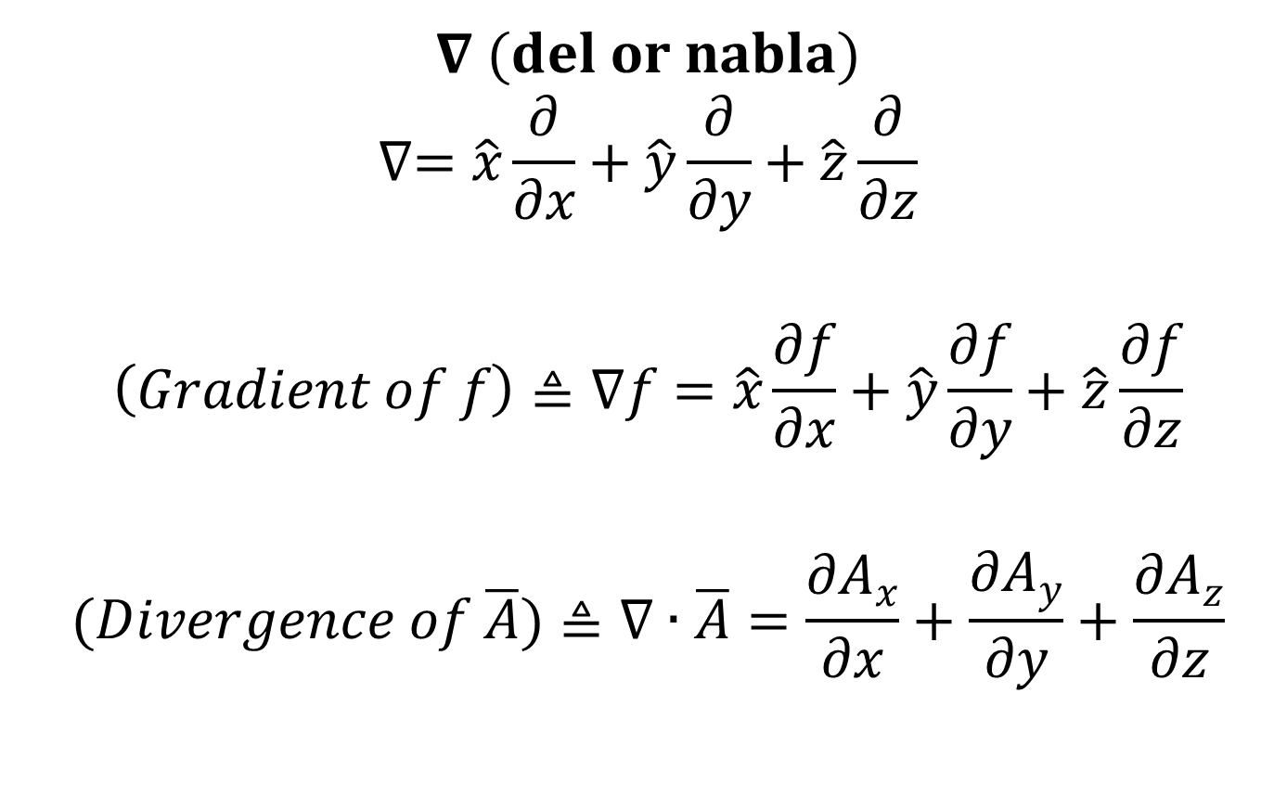
Vector Calculus
$$∇ (del or nabla)$$
$$∇=\hat{x}\frac{∂}{∂x}+\hat{y}\frac{∂}{∂y}+\hat{z}\frac{∂}{∂z}$$
$$\left(Gradient of f\right)≜∇f=\hat{x}\frac{∂f}{∂x}+\hat{y}\frac{∂f}{∂y}+\hat{z}\frac{∂f}{∂z}$$
$$(Divergence of \overline{A})≜∇∙\overline{A}=\frac{∂A_{x}}{∂x}+\frac{∂A_{y}}{∂y}+\frac{∂A_{z}}{∂z}$$

Slide 52
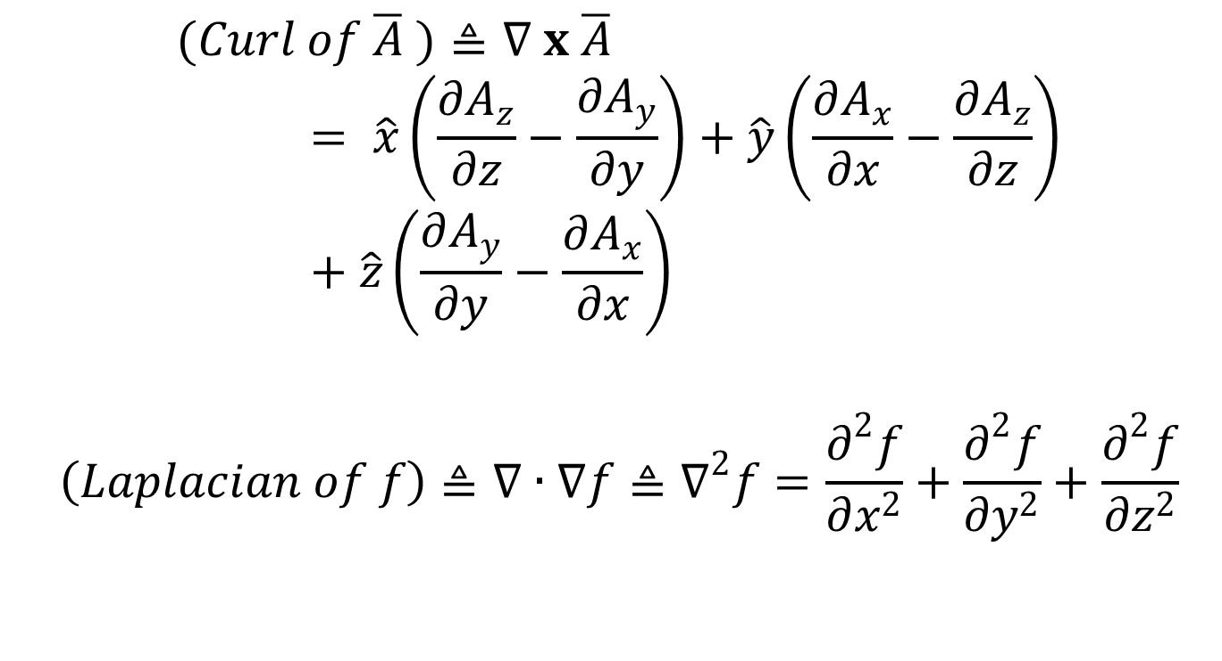
$$(Curl of \overline{A} )≜∇ x \overline{A}= \hat{x}\left(\frac{∂A_{z}}{∂z}−\frac{∂A_{y}}{∂y}\right)+\hat{y}\left(\frac{∂A_{x}}{∂x}−\frac{∂A_{z}}{∂z}\right)+\hat{z}\left(\frac{∂A_{y}}{∂y}−\frac{∂A_{x}}{∂x}\right)$$
$$\left(Laplacian of f\right)≜∇∙∇f≜∇^{2}f=\frac{∂^{2}f}{∂x^{2}}+\frac{∂^{2}f}{∂y^{2}}+\frac{∂^{2}f}{∂z^{2}}$$

Slide 53
